Slide 1
USING RILM ABSTRACTS
A beginners’ guide to using RILM for literature searching

Slide 3
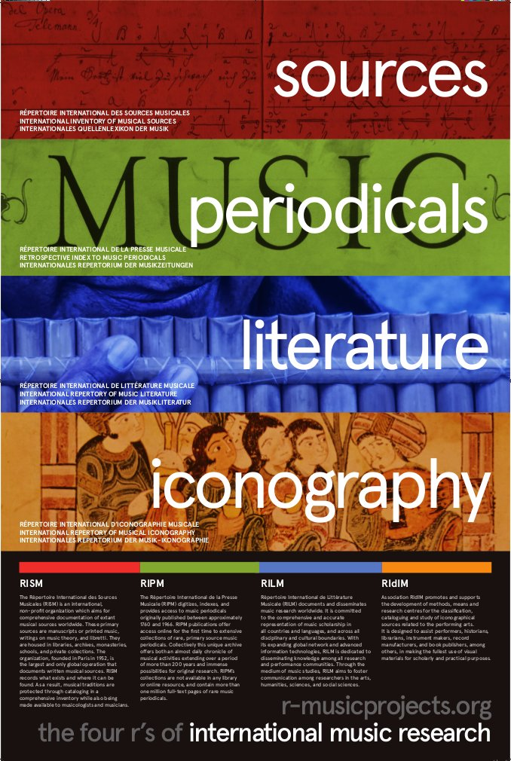
RISM – Répertoire International des Sources Musicales
Locations for music manuscripts and early printed editions
RIPM – Répertoire International de la Presse Musicale
Historic journal articles
RILM – Répertoire International de Littérature Musicale
What’s been written about music
RIdIM – Répertoire International d’Iconographie Musicale
Pictorial representations of music, musicians or instruments

Slide 4
Journal articles
Dissertations
Conference papers
Abstracts of -
Symposia
Festschriften
Some monographs

Slide 5
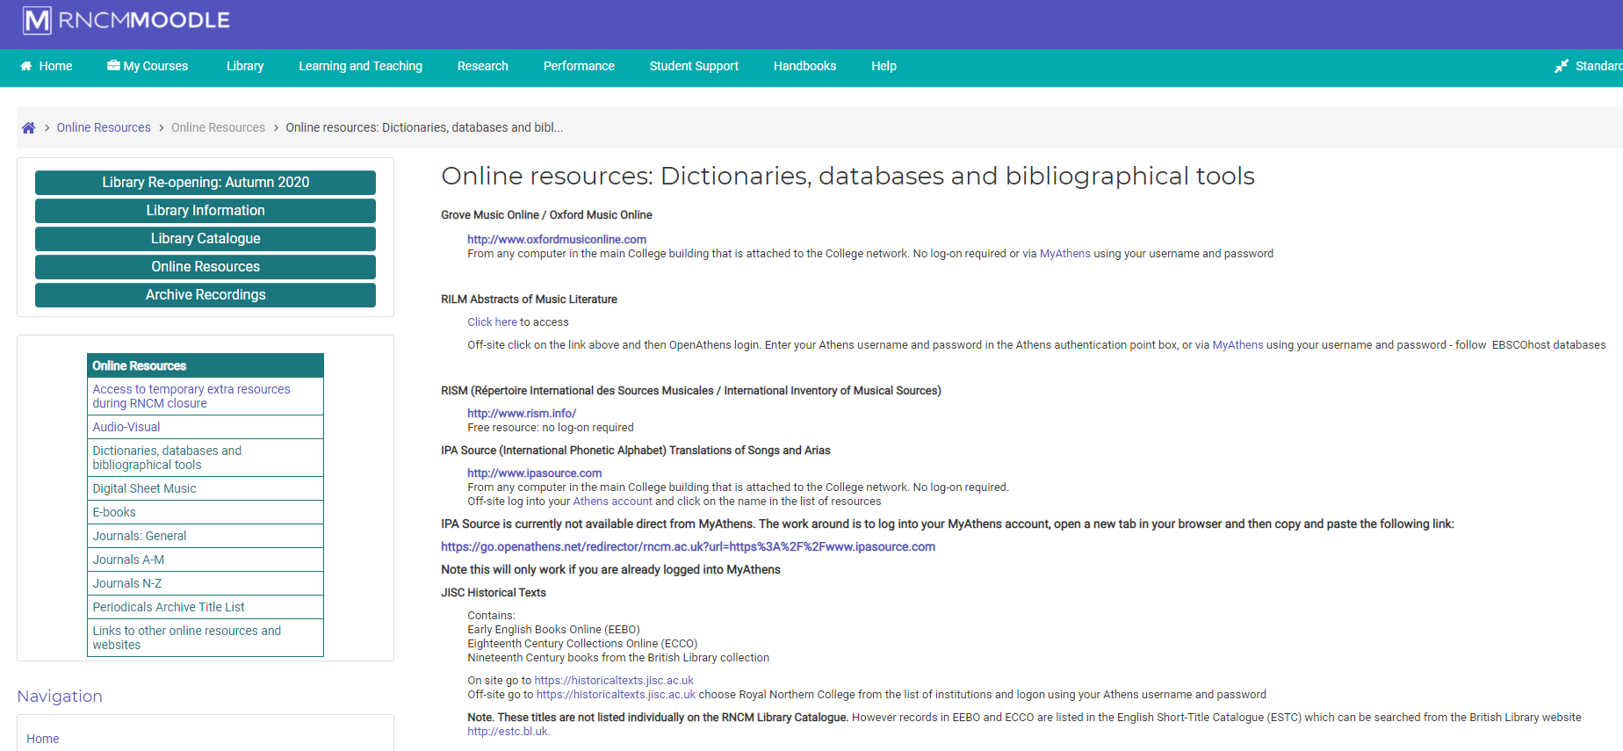

Slide 6
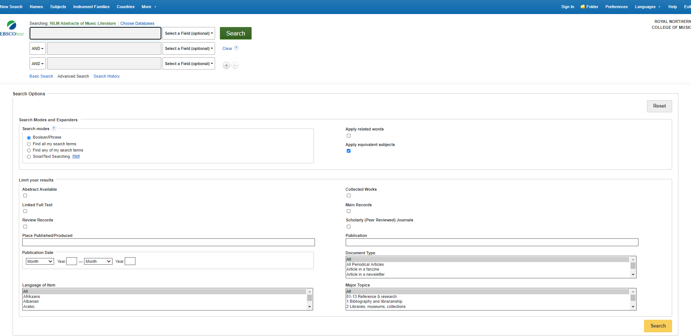

Slide 7
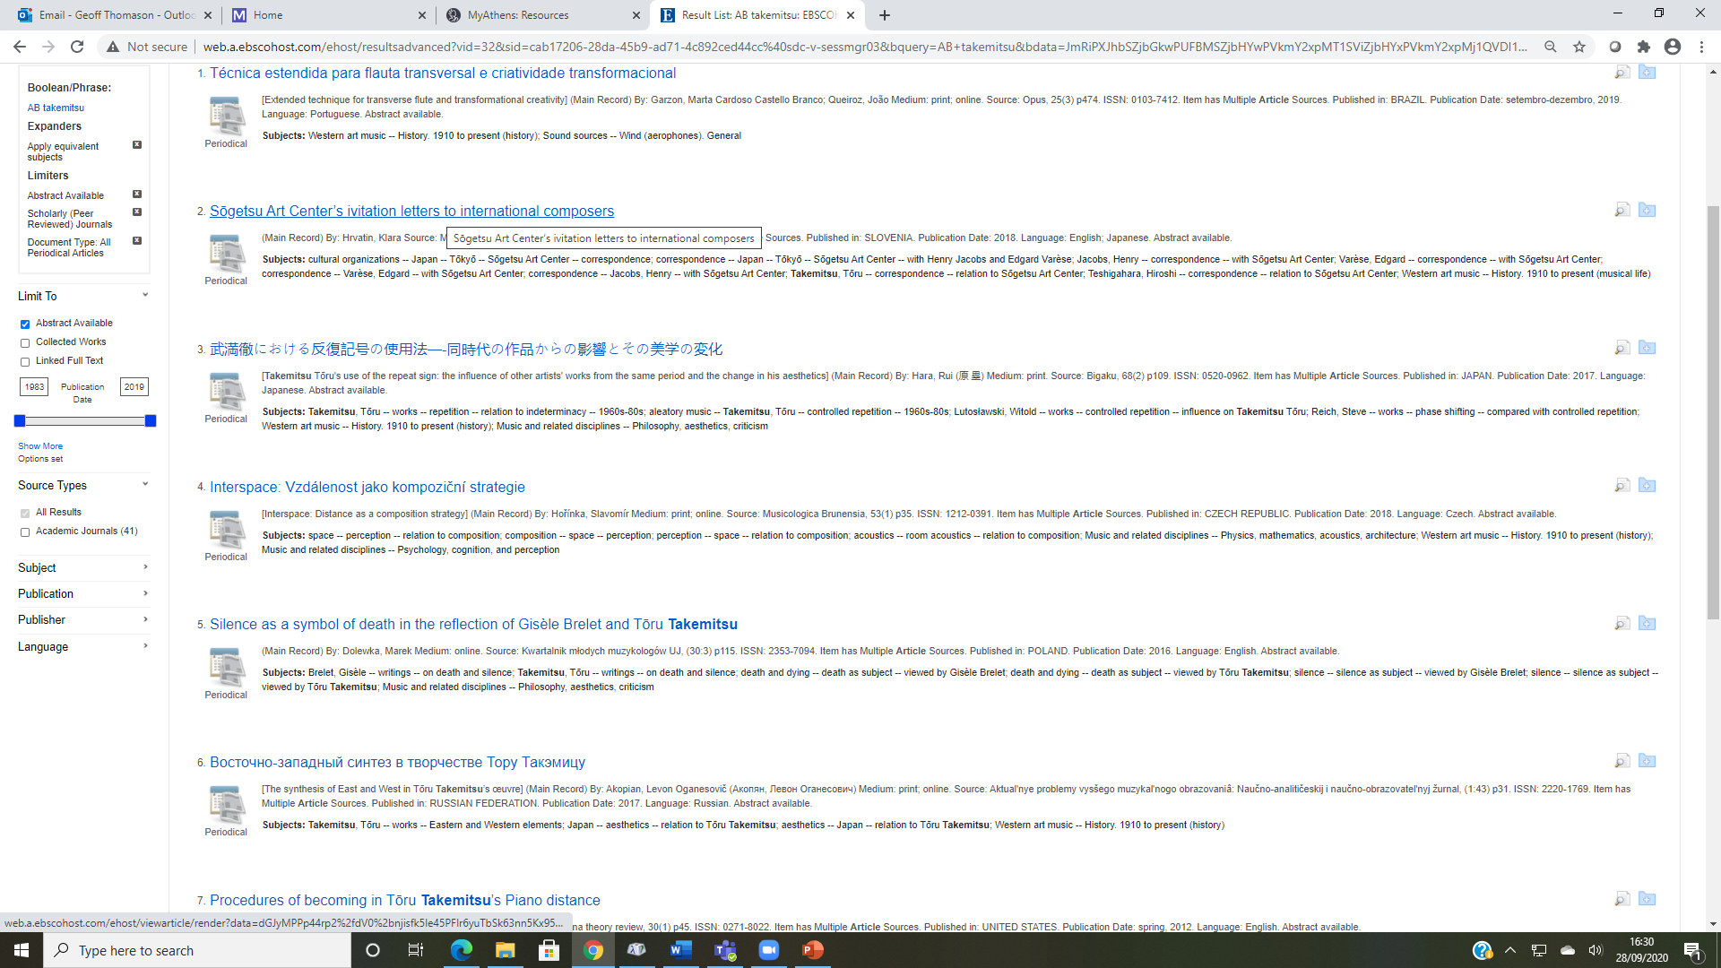

Slide 8
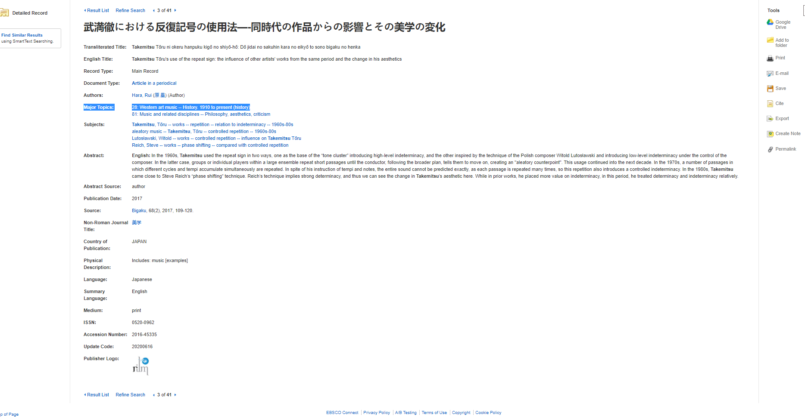

Slide 9
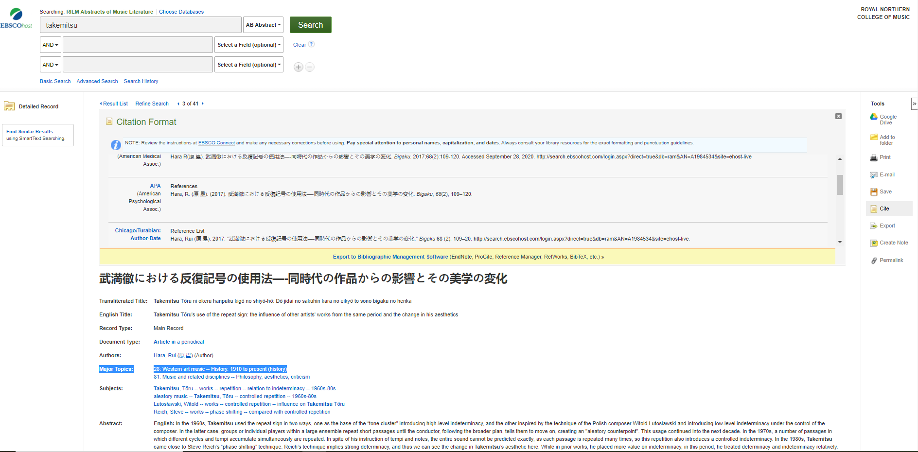

Slide 10
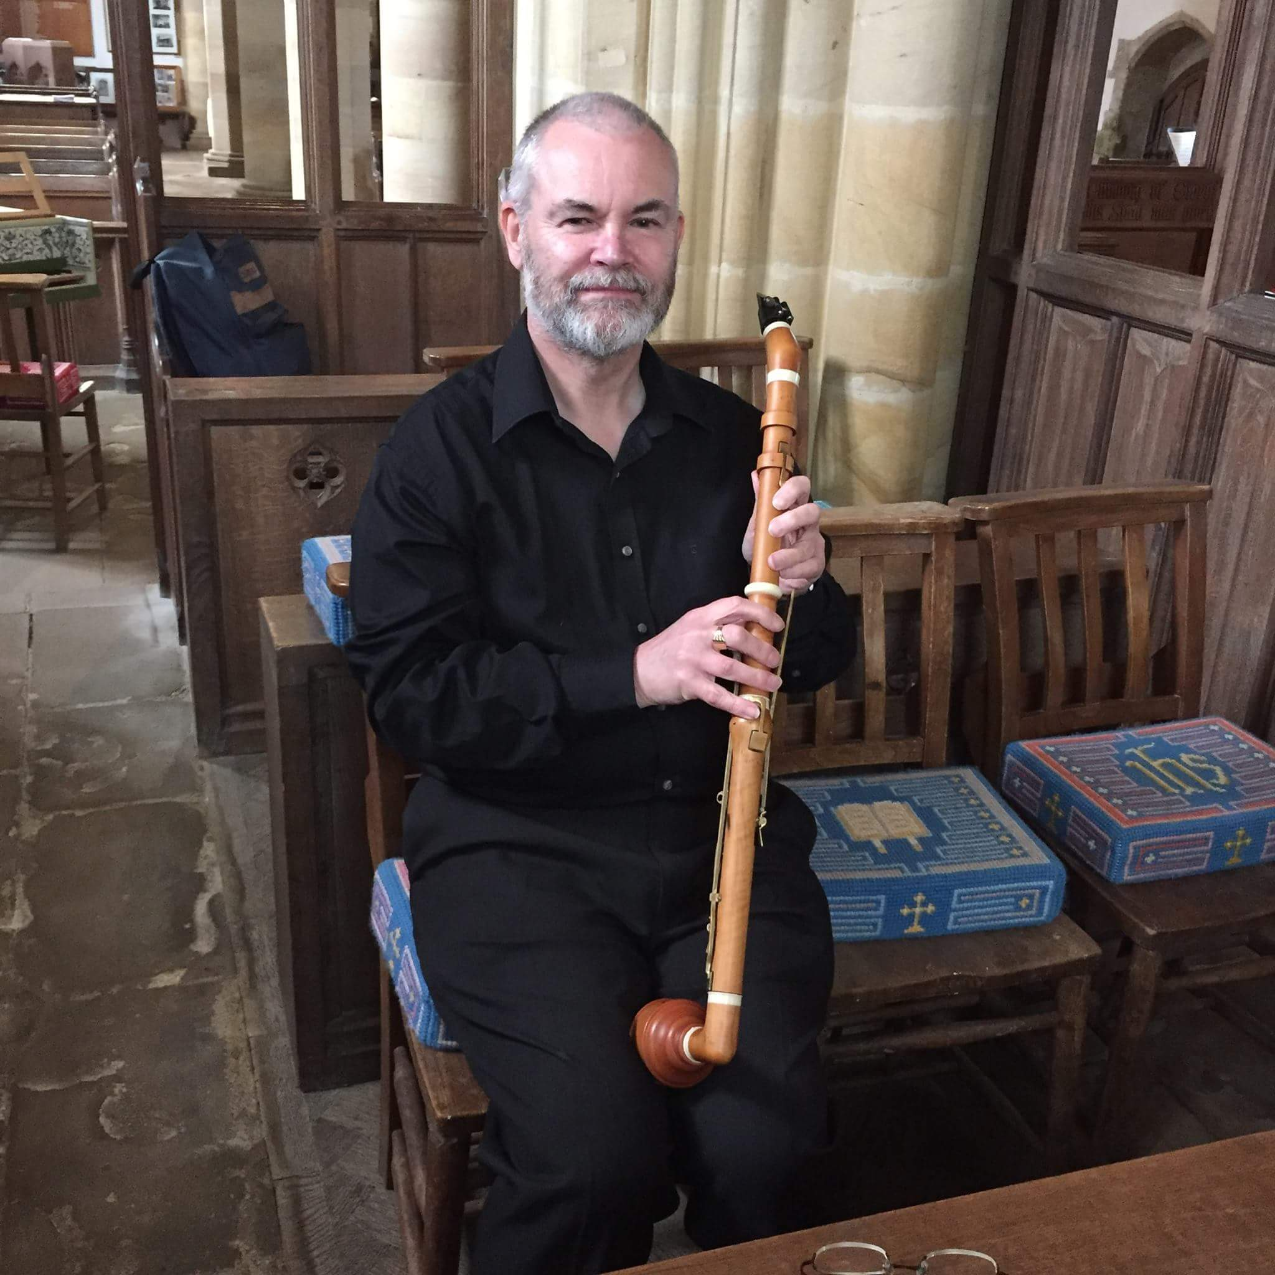
Dr Geoff Thomason
Deputy Librarian (Research)
geoff.thomason@rncm.ac.uk

