Slide 1
A user’s guide to the RNCM Library catalogue

Slide 2
This guide is designed to help you find your
way round the Library’s online catalogue
You can work through it at your own pace
If there is anything you would like help with, please
ask a member of the Library staff. We will be happy
to assist you
We are constantly seeking ways to make the online
catalogue easier to use, so your comments are always
welcome

Slide 3
The Library catalogue shows you
What books, printed music and audio visual material (CDs/DVDs) are available in the Library
Where you can find it on the shelves
Whether it is currently in the Library or out on loan
The catalogue is available at http://catalogue.rncm.ac.uk

Slide 4
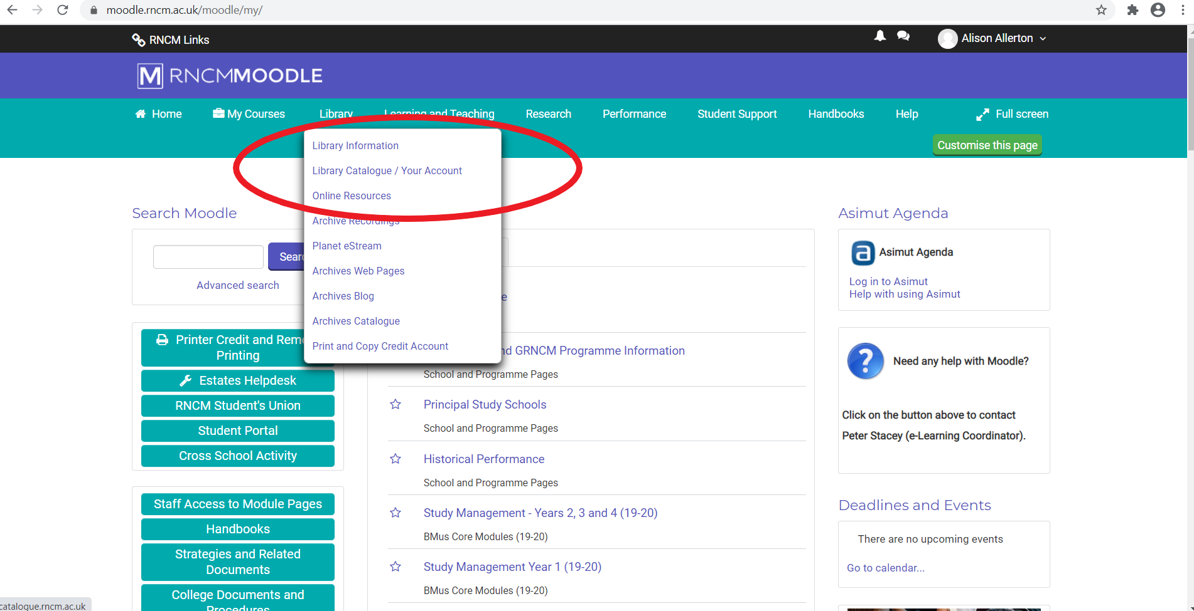
Or go to the Library section of RNCM Moodle and click on Library Catalogue/Your Account

Slide 5
You can choose what type of material you would like to search for using the drop down menu on the left, for example, Audio-visual, books, music or short loan. This means that the results will be more relevant to your search.
Enter your search terms (keywords) in the box provided

Slide 6
Some tips when searching for books
A keyword search allows you to search simultaneously on an author’s name and words from the title
You don’t need to know the whole title – just relevant words within it
Words like “a”, “an”, “the” or “and” are ignored by the system so you can leave them out
The more words you search on, the more you can narrow down your search. It’s useful to remember this if, for instance, an author has a common surname.
You can also search on names other that the author’s, e.g. those of collaborating authors or editors

Slide 7
Some tips when searching for printed music
Many titles are generic, e.g. “symphony”, “sonata”, “trio”, so you will always need to add more terms to narrow your search
These can include for example a composer’s name, the scoring, the key, opus no. or thematic catalogue no. of a piece (e.g. K.488 for Mozart), or a nickname
So, if you are looking for Beethoven’s “Waldstein” sonata you can search on any combination of the underlined terms - Beethoven, Ludwig van. Sonata for piano op.53 in
C major Waldstein (note that you need the op.)
You don’t need to add punctuation

Slide 8
Some tips when searching for recorded music
What applies to searching for printed music also applies
here, but note that:
You can search for specific artists as well as composers
If you’re looking for recordings using period instruments you can use “period instruments” as search terms with name or title keywords, e.g. “Brandenburg period instruments” will find all the relevant recordings of the Brandenburg concertos, while “Bach period instruments” will find all Bach recordings on period instruments (that’s all the Bachs unless you add forenames to limit your search).
You can’t search for vinyl LPs on the online catalogue – you will need to use the card catalogue

Slide 9
Doing a search
Let’s imagine you’re looking for the sheet music of the opus 69 cello sonata by Beethoven. Select “Music” from the dropdown menu on the left, and enter the following search terms. You have to enter the opus number as op.69 (with no spaces)
Beethoven sonata cello piano op.69
Click on Search or press Enter

Slide 10
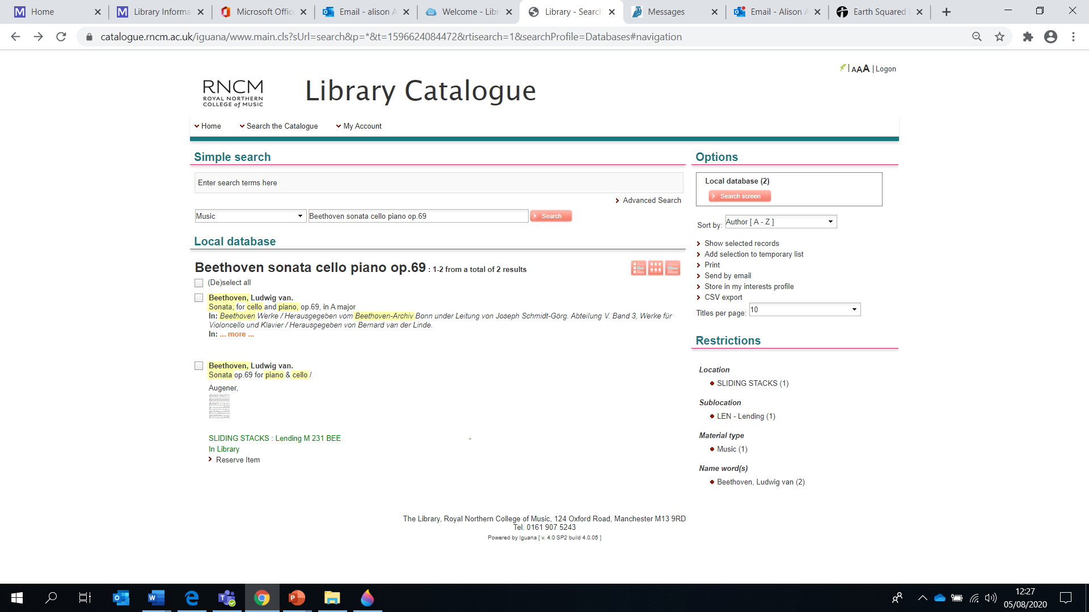
You will see a list of catalogue records which contain the words you’ve searched with. Some of these are brief records for items in the Library
Others are a description of the piece and a listing of where it can be found for example within a volume of sheet music, CD or DVD

Slide 11
Brief record
A brief record gives you enough information to be able to identify whether this is the copy you want e.g. this is an Augener edition
From this information you can see where the item is shelved in the Library (the shelf mark), in this case M 231 BEE. This particular item is in the Sliding Stacks. You can ask at the Library counter for this.
If the item says LENDING, it is on the main Library shelves.
You can also Reserve the item from here.

Slide 12
The top item on your original results list shows that this sonata can be found in various volumes of music, CDs and DVDs
Click on this link to give a full list of items containing the sonata, then click on the item which you need from the list, for example for the edition edited by Jonathan Del Mar, click on the item shown

Slide 13
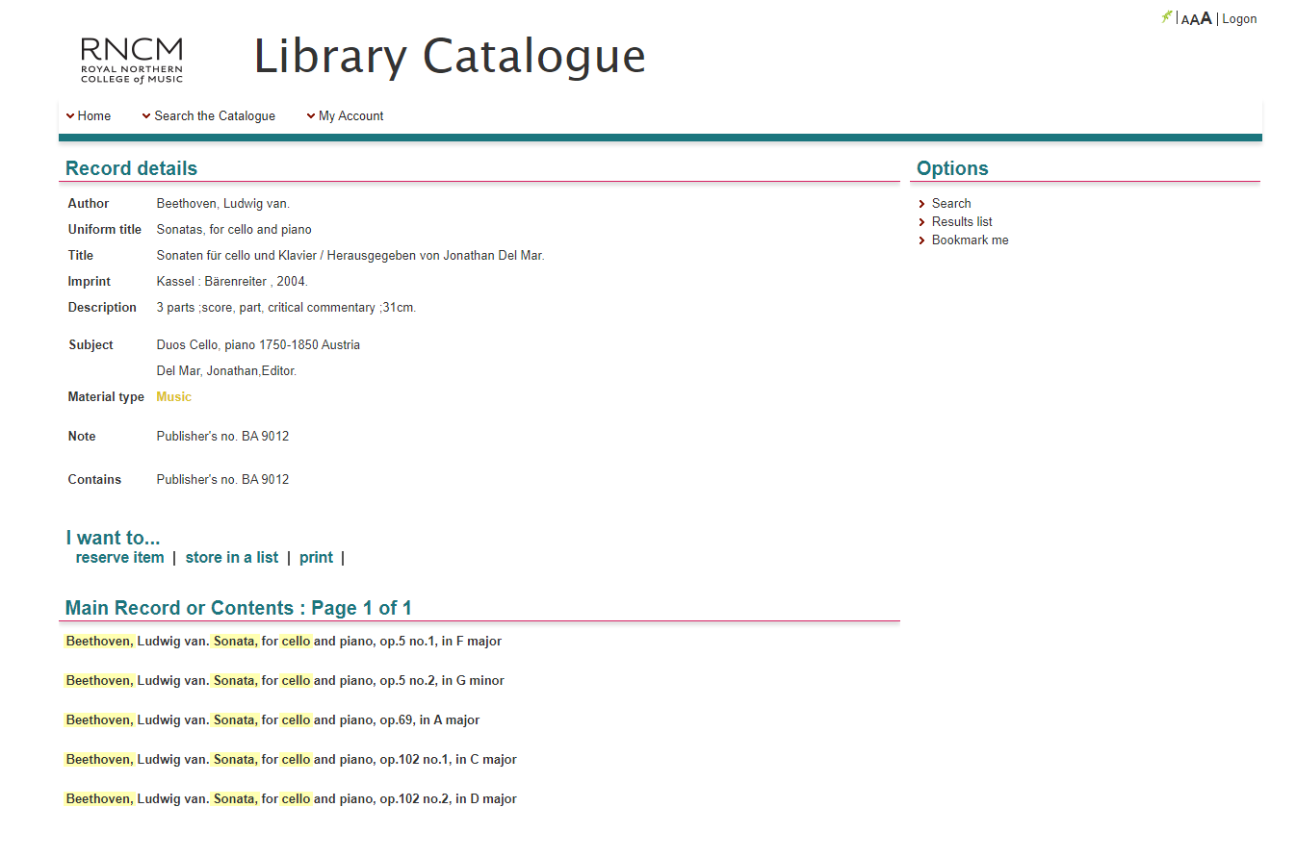
Full record
This contains the full bibliographic description for the item and the holdings information
This shows you the number of parts the item contains and its physical size
These are the subject terms assigned to the item
This section shows the contents of the volume, including the piece you’re searching for. These are all hyperlinks, so you can click on them and go straight to other items containing the same piece

Slide 14
Further down the screen, you can find the
item details, including where to find it in the
Library.
The item category tells you what kind of material the item is:
Music = Printed music
Book = Books
Music 7 day = Printed music available for 7 day loan
Book 7 day = Books available for 7 day loan
CD = CD
DVD = DVD
Video = Video
Music set = Orchestral set

Slide 15
What does Shelfmark mean?
The shelfmark shows where an item is located on the
shelves. This includes whether it is in the Main lending/Reference/Audio-visual section or Reserve or Short loan. The shelfmark also includes the items classification (classmark).
Every book or piece of music in the Library is
classified so that books on a similar subject or music for the same instrumental combinations can be shelved together.
In this case “M 231” is music for cello and piano. The letters BEE after the number means that this is music by Beethoven. This would also mean that Brahms cello sonatas would be at M 231 BRA

Slide 16
What does Availability mean?
This gives the current status of the item
In Library – the item should be on the shelf; ask a member of Library staff if you can’t find it
No copy available Due: -The Item is out on loan and is due on the date displayed (if no date, ask at the Library counter)
Other status messages you might see are: On display – The item is on display within the Library, ask at Counter if you cannot find the item Missing – The item should be on the shelves but cannot be found by staff On Order – the item has been ordered but has not yet arrived in the Library

Slide 17
What if you want to look for books on a certain
subject or for music for certain instruments?
Click on Search the Catalogue and then Advanced search and choose the Subject search from the drop-down box
Every item record contains subject terms which allow you to search by topic (for books), scoring (for music), country of origin and date
Because these terms are fixed, it’s useful to be familiar with how they work. If you use a subject keyword which the catalogue doesn’t recognise your search won’t pick up material which is relevant to what you’re looking for. This is to ensure consistency.

Slide 18
How to search by subject / scoring
When searching by genre or scoring, always use plurals, i.e.: concertos, sonatas, quintets, operas, symphonies, etc.
For music for one instrument, use solos
For music for two instruments, use duos
Thereafter it’s logical: trios, quartets, quintets, sextets, septets, octets, nonets, dectets
For more than 10 instruments, use ensembles
If you wanted specifically to see what was available for oboe
and piano, your keywords would be duos oboe piano
(The order of the words doesn’t matter)

Slide 19
Extending the search by date
You can search by century by using this formula:
For e.g. the 19th century, search on 1801-1900
For e.g. late 18th to early 19th century, search on 1750-1850
Imagine you want to find 20th century music for oboe and piano. This time you could search on
duos oboe piano 1901-2000
If you wanted books on the history of the violin or violin music
in the 18th century you could search on
violin history 1701-1800

Slide 20
Extending the search by country
If you want music from a particular country you can use the name of the country as a search term.
For example, to find 20th century music for oboe and piano by French composers you could search on
duos oboe piano 1901-2000 France
If you want books on the history of the violin or violin music in Italy in the 18th century you could search on
violin history 1701-1800 Italy
Again, the order of the keywords doesn’t matter – it never does

Slide 21
What if I can’t spell the keywords I want to search on?
Some spellings can be tricky, especially composers’ names.
Names transliterated from non-Roman alphabets like Cyrillic are the trickiest of all. Is it Tchaikovsky, Tschaikowsky or Chaikovskii, Rachmaninov, Rakhmaninov or Rachmaninoff?
If we used all the common variants of names like these it would make searching very difficult. That’s why we have to adopt a single, standardised spelling for all appearances of same composer’s name – and not just surnames either

Slide 22
Other useful information
Saving items to a list
From the results screen you can either save all of the results or select a few records and put them into a save list
You can then view and edit the save list and send it to yourself as an email, print it, or if you are logged in you can save it to your account and return to it later

Slide 23
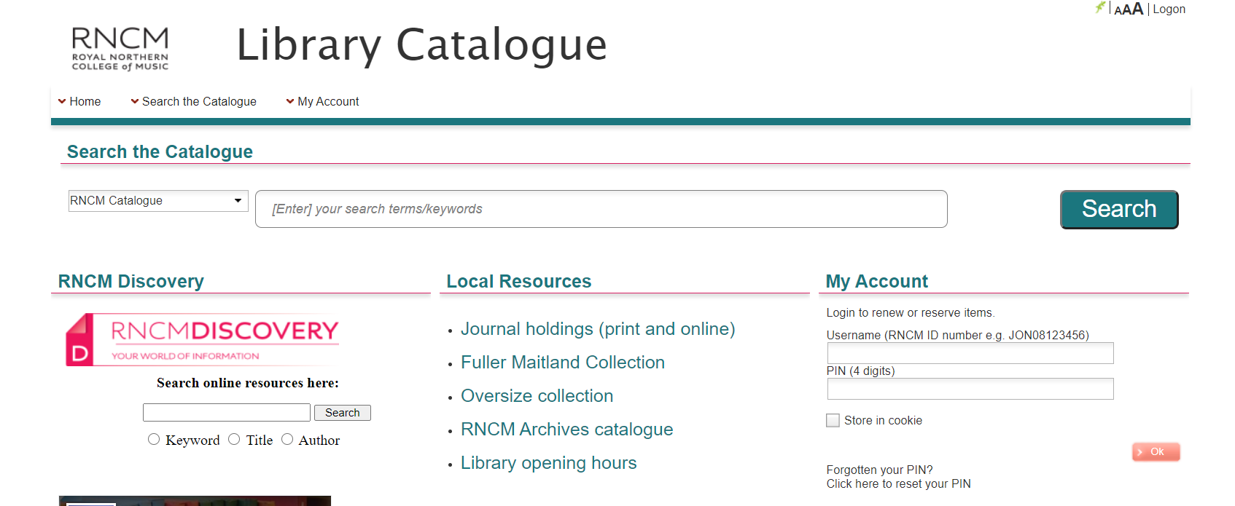
Other useful information
You can access your Library account from any page of the catalogue by clicking Logon in the top right hand corner, or from the main page “My Account” section.
Your username is your RNCM ID card number and your PIN is 4 digits (please ask Library staff for details of your PIN)

Slide 24
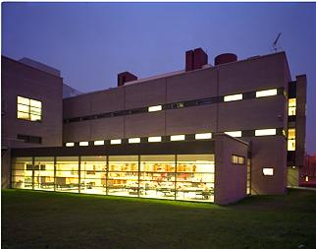
This is the end of this brief guide. We hope
you have found it useful
Remember – we are here to help you find the resources
you will need during your time at the RNCM. If you have
any problems in finding those resources, please ask any
member of the Library staff
Happy searching!
RNCM Library
August 2020

