Slide 1
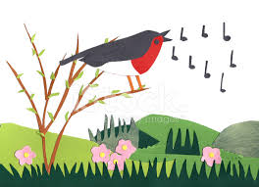
The Alexander Technique
Introduction for singers

Slide 2
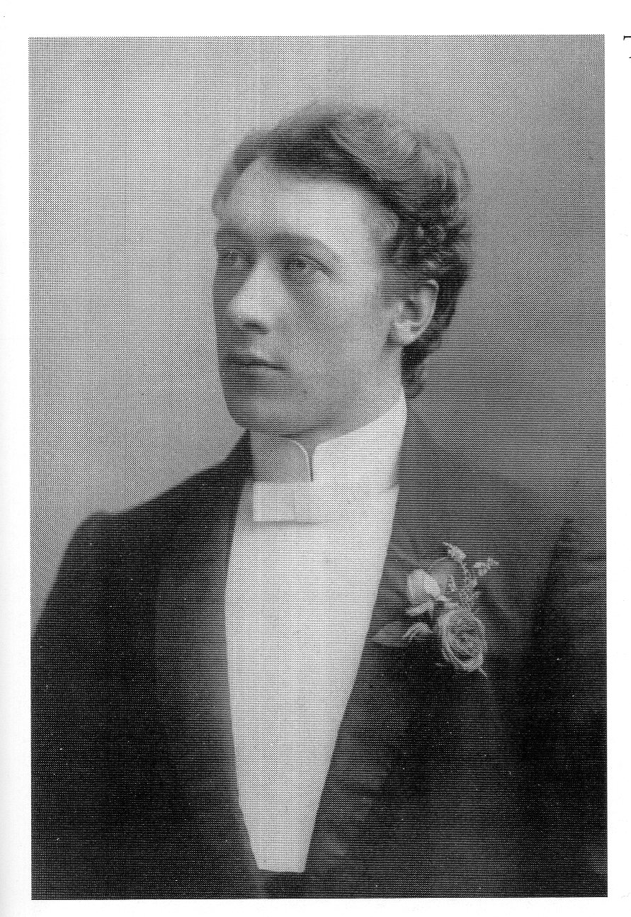
F Matthias Alexander
Australian actor in the 1890s

Slide 3
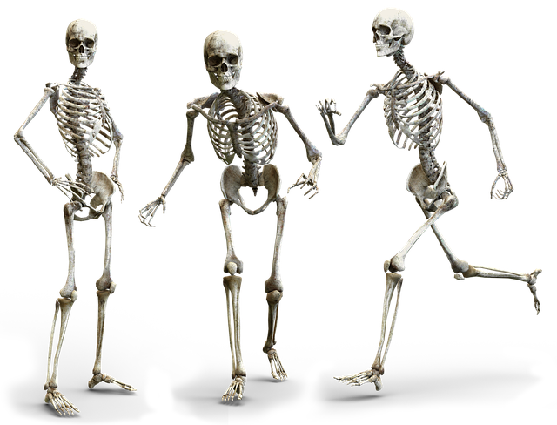
Bones
Shape/Form
Support
Stability
Movement
Protection

Slide 4
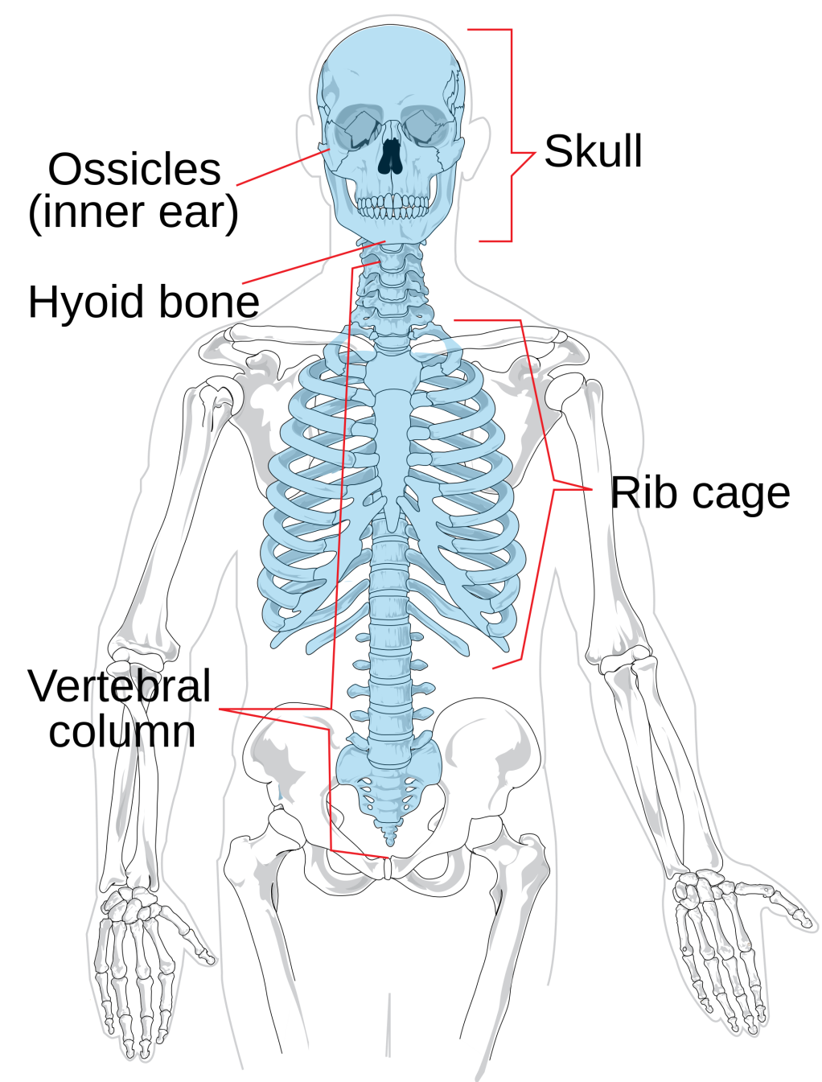
Axial skeleton
Skull
Hyoid bone
Vertebral column
Ribs
Sternum
Appendicular skeleton
Shoulders/arms
Pelvis/legs

Slide 5
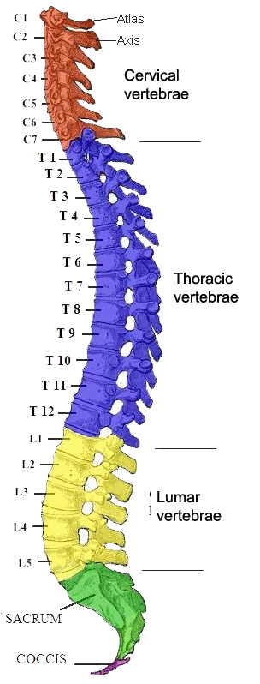
Vertebral column (spine/backbone)
Cervical – 7
Thoracic 12
Lumbar -5
Sacrum – 5 fused
Coccyx – 4 fused
Curves – primary/secondary

Slide 6
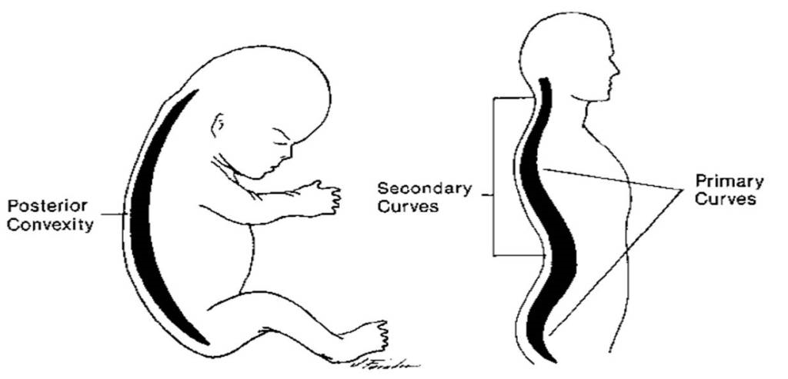
Curves are compensatory to each another
Primary curves
Secondary curves
Secondary curves
cervical
lumbar
Primary curve

Slide 7
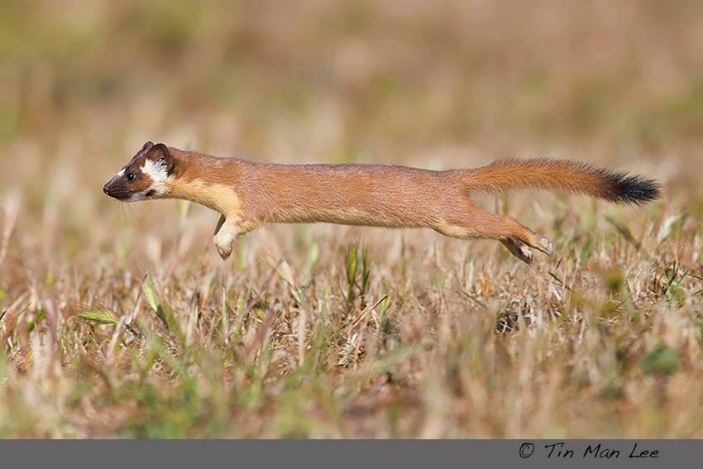
Nose to tail

Slide 8
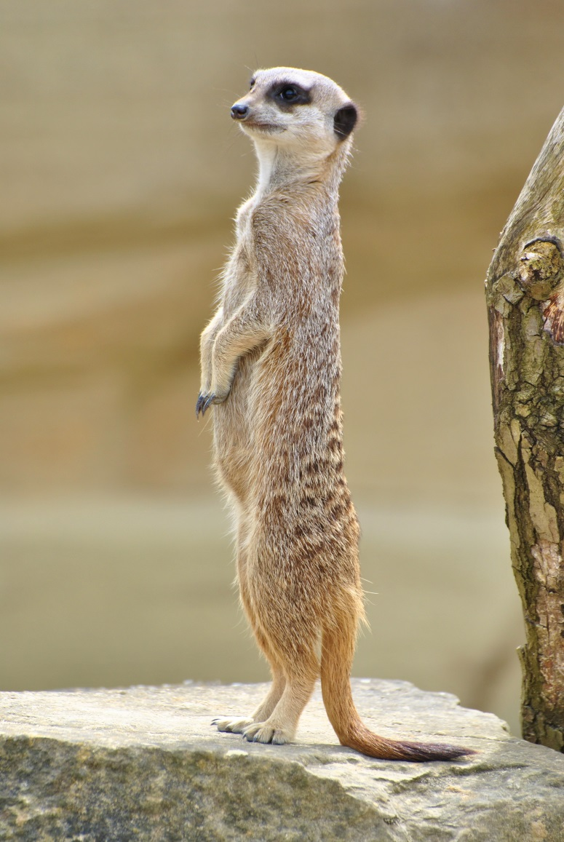
NB Tail forming tripod!
Head to toe

Slide 9
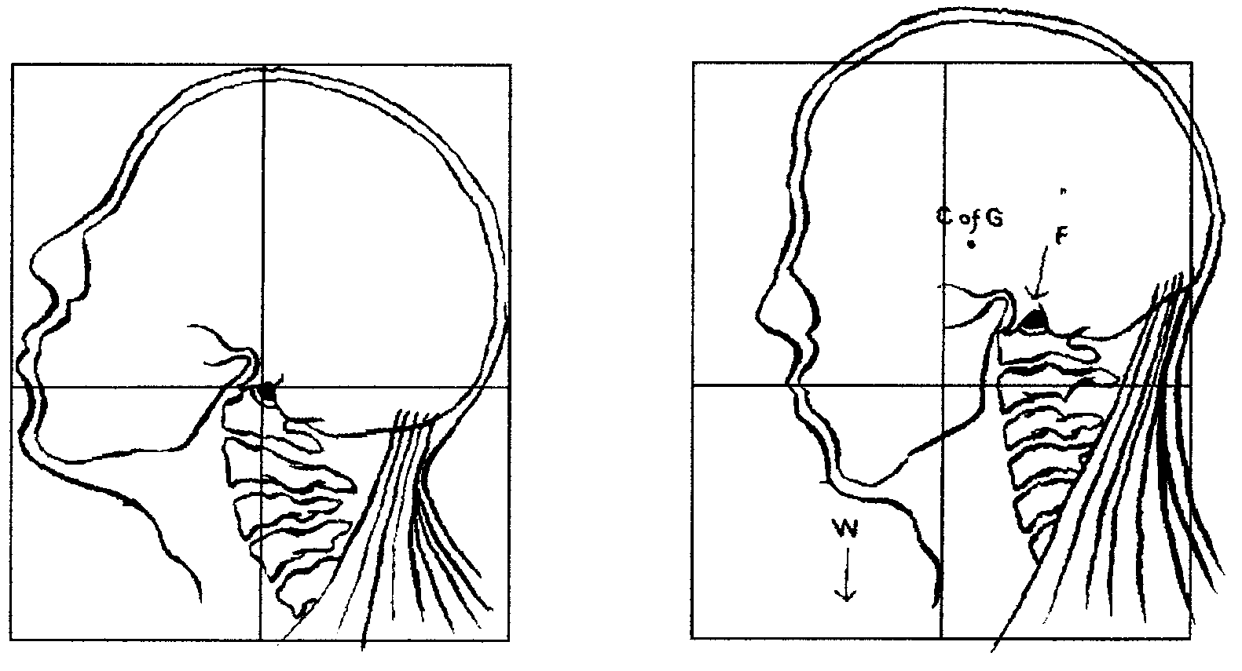
Head pulled backward and down
Neck “free” allowing the head forward and up

Slide 10
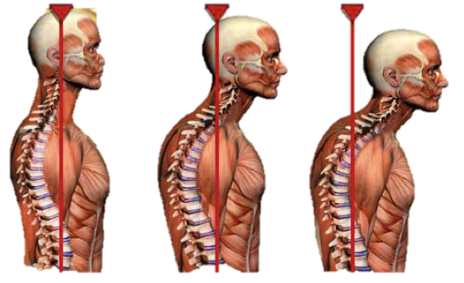
Problem with poor head position
Head weighs 5.75kg/12.5lbs
Every 1 inch (2.5cm) forwards adds an extra 6kg force (weight) onto the neck!!!

Slide 11
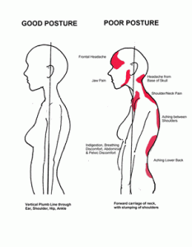
Poor head position causes problems with all levels of the back (and body)
Domino effect
Head’s centre of gravity moves forward
Upper body drifts back
  to compensate
The pelvis tilts forward
  to compensate

Slide 12
Thinking tall

Slide 13
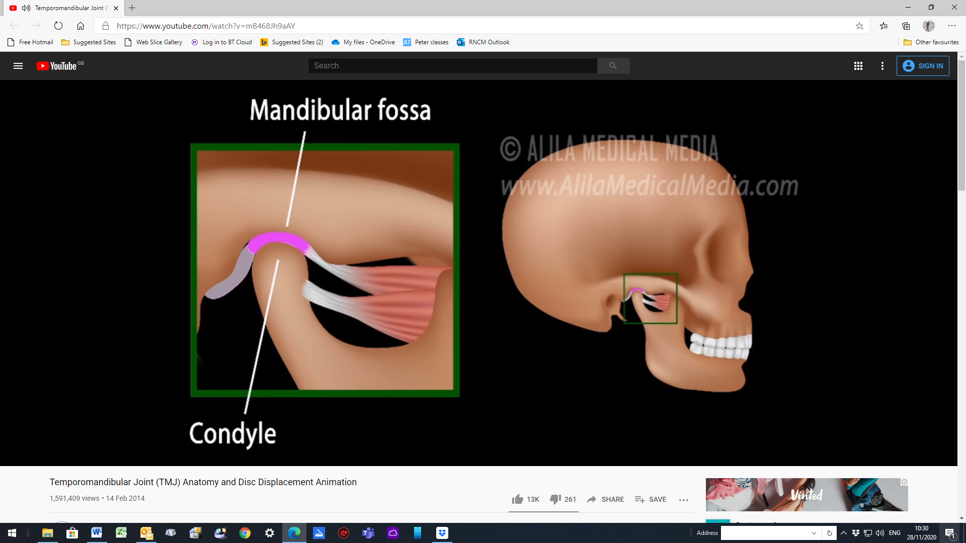
The Jaw – ‘temporo-mandibular joint’
“The mandible is the only bone that moves when the mouth opens.”
The jaw pivots open for the first 20mm
(2) the condyle slides forward to open the mouth fully.
Alila Medical Media https://www.youtube.com/watch?v=mB468Jh9aAY

Slide 14
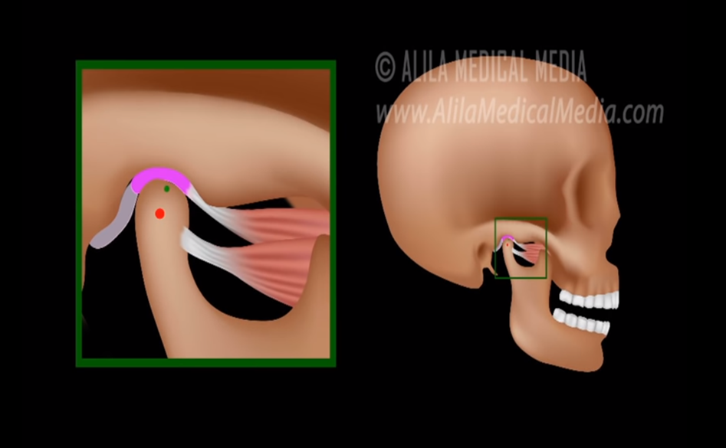
The Jaw – ‘temporo-mandibular joint’
“The mandible is the only bone that moves when the mouth opens.”
The jaw pivots open for the first 20mm
(2) the condyle slides forward to open the mouth fully.
Alila Medical Media https://www.youtube.com/watch?v=mB468Jh9aAY

Slide 15
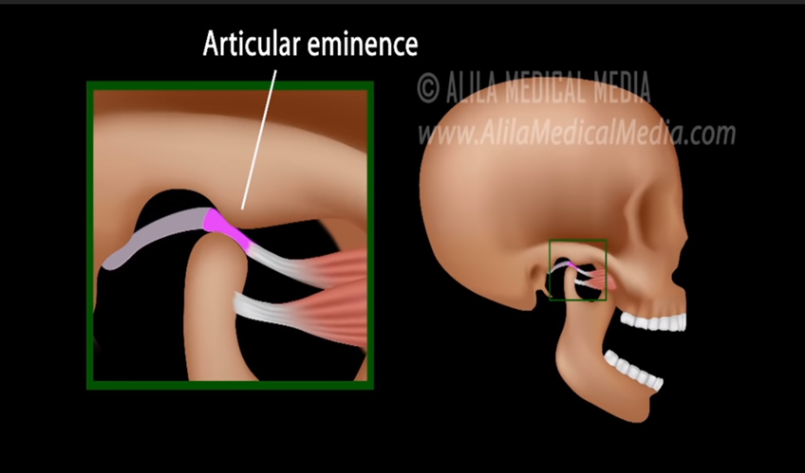
The Jaw – ‘temporo-mandibular joint’
“The mandible is the only bone that moves when the mouth opens.”
The jaw pivots open for the first 20mm
(2) the condyle slides forward to open the mouth fully.
Alila Medical Media https://www.youtube.com/watch?v=mB468Jh9aAY

Slide 16
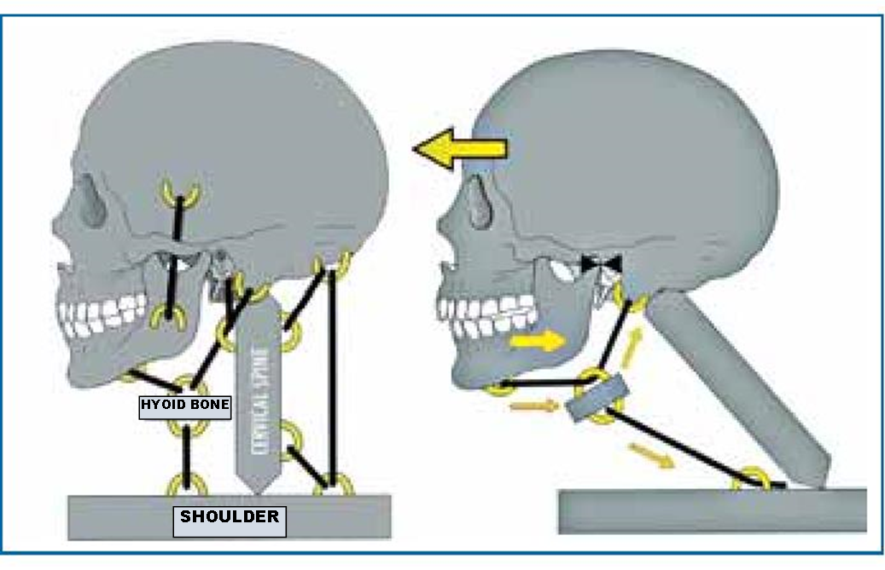
Neck forward disrupts the suspension of the larynx

Slide 17
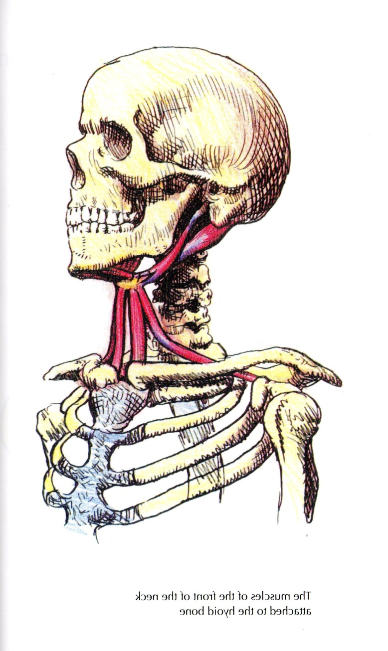
Hyoid bone
Located between the mandible (jaw) and larynx
Does not articulate with another bone
Provides support for the tongue
Provides attachment for muscles

Slide 18
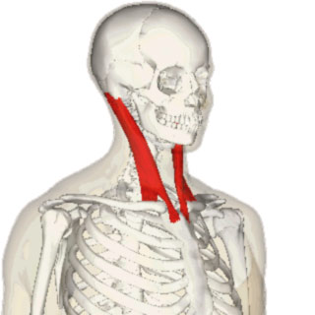
Sterno-mastoid muscles
From sternum and clavicle to mastoid process
Important landmark forming the Neck
Function
  tip the head back to look up
  pull the neck forward
  accessory breathing, elevate sternum and clavicle (but not to sing!)

Slide 19
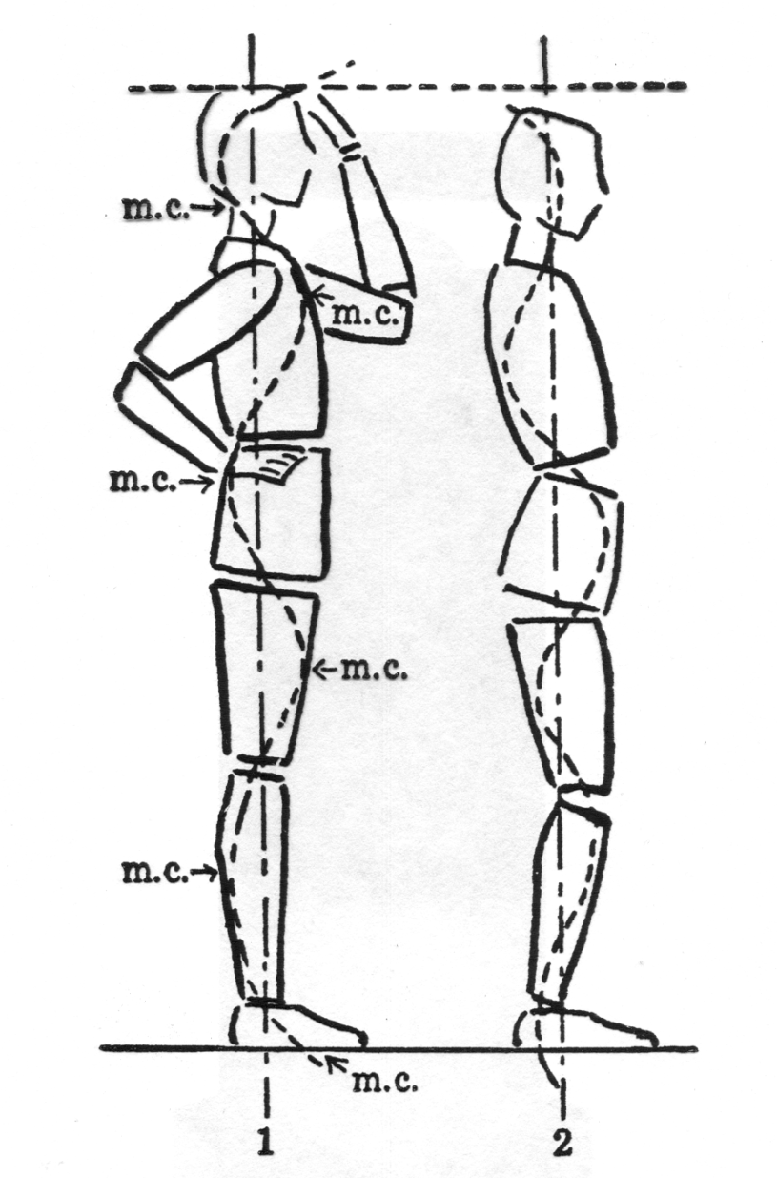

Slide 20
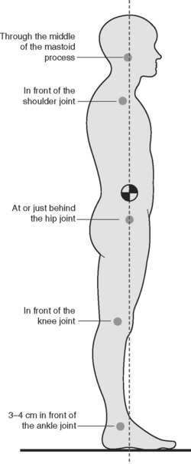
In relaxed standing, the body’s weight passes:
through the hip joints
Just in front of the knee joints, and
Just in front of the ankles
It should be easy to go up onto toes without moving hips forward.

Slide 21
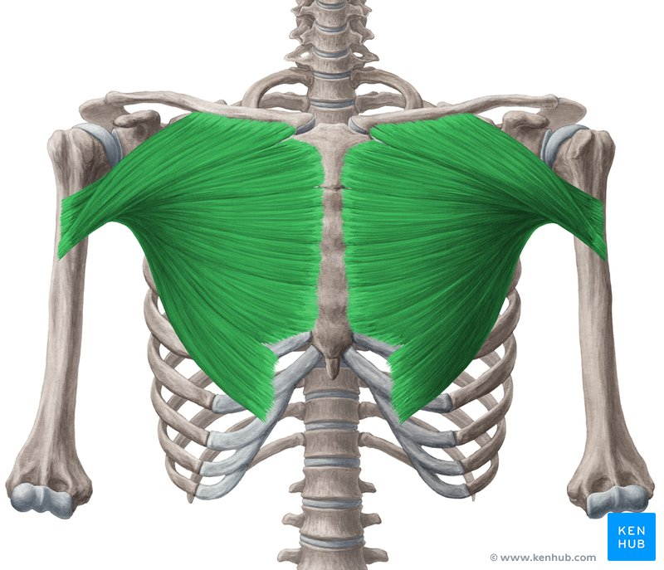
Pectoralis major
Widen across the upper chest (along the collar bones); include the arms

Slide 22
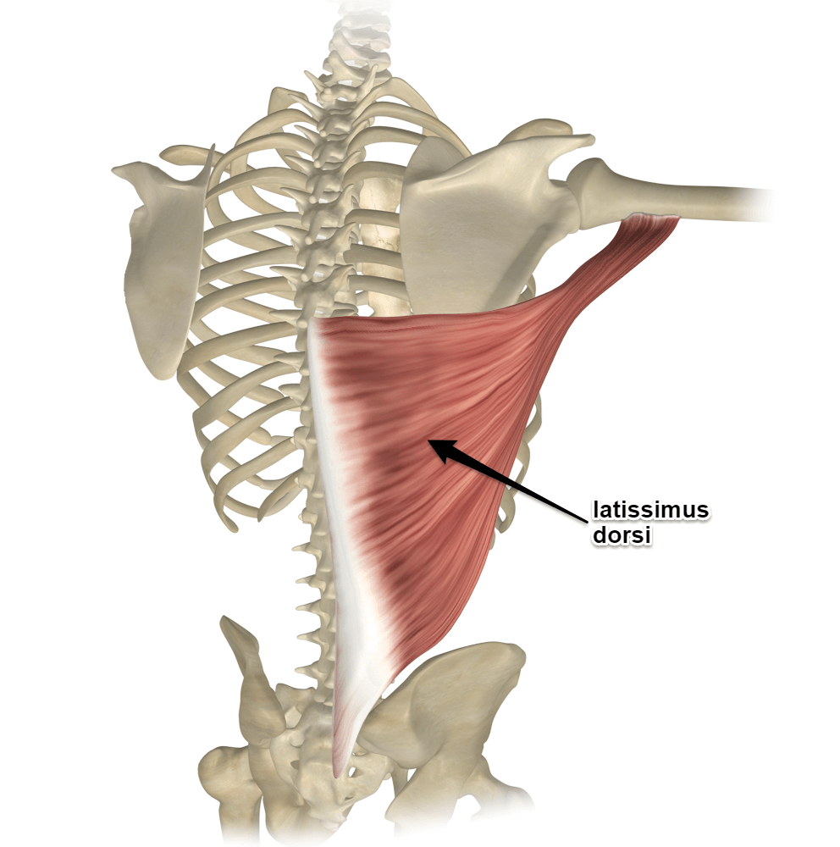
Latissimus dorsi
Allow the back to widen

Slide 23
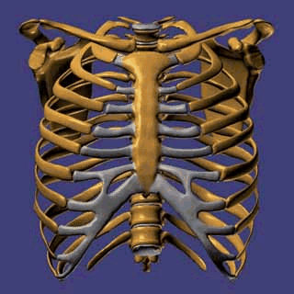
Ideally, the collar bones and first ribs are stabilized as the other ribs are drawn upward by the intercostal muscles (i.e. not as shown).
https://hal.bim.msu.edu/CMEonLine/RibCage/Biomechanics/start.html

Slide 24
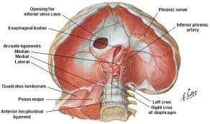
Psoas muscle

Slide 25
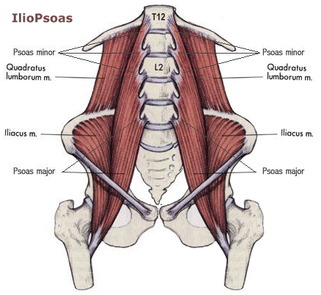

Slide 26
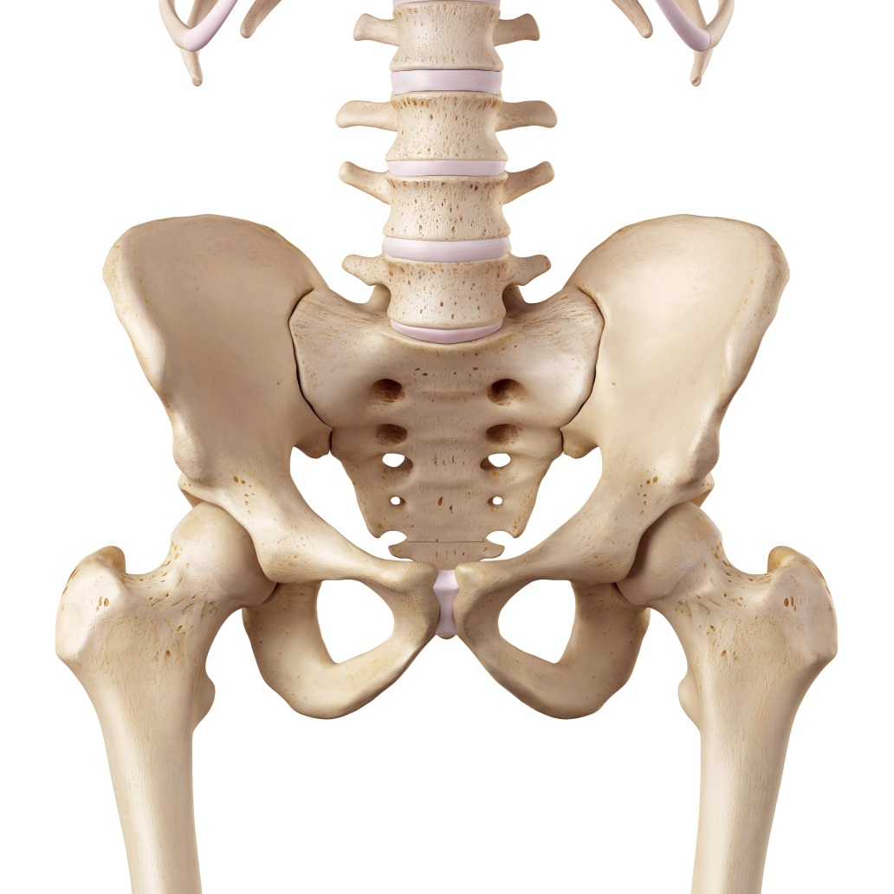
Hip bone
Hip joint
Trochanter

Slide 27
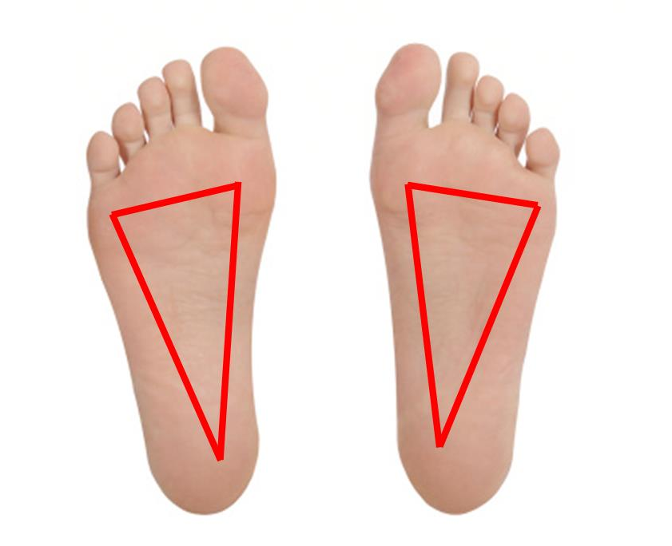
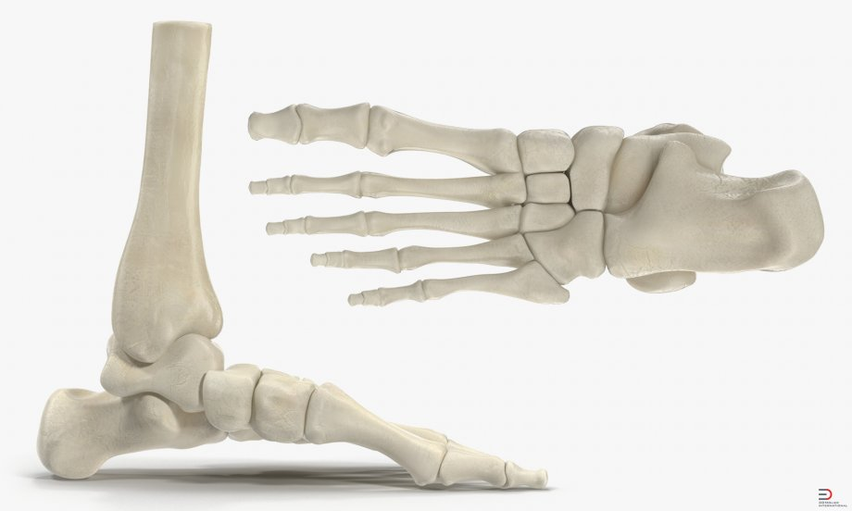
Up to 22½⁰
22½⁰

Slide 28
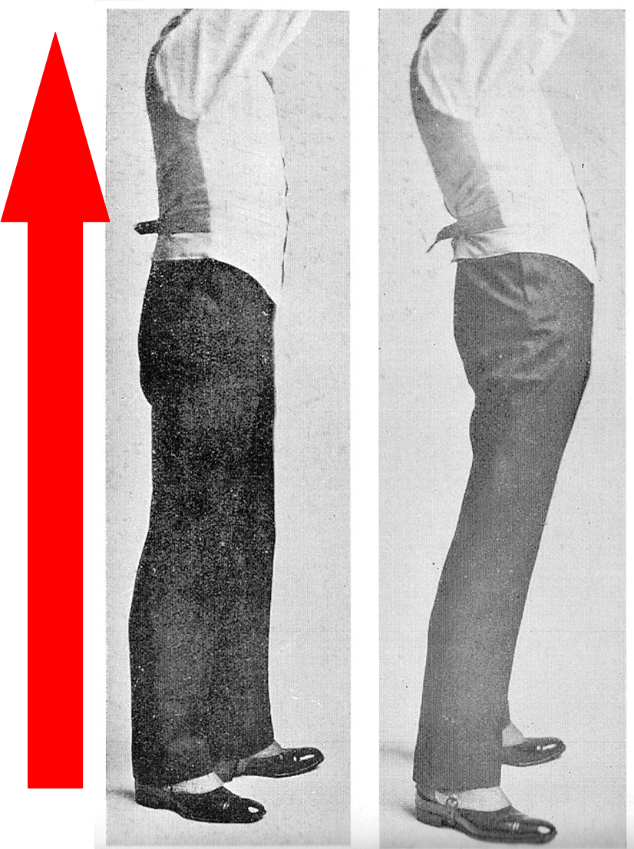

Slide 29
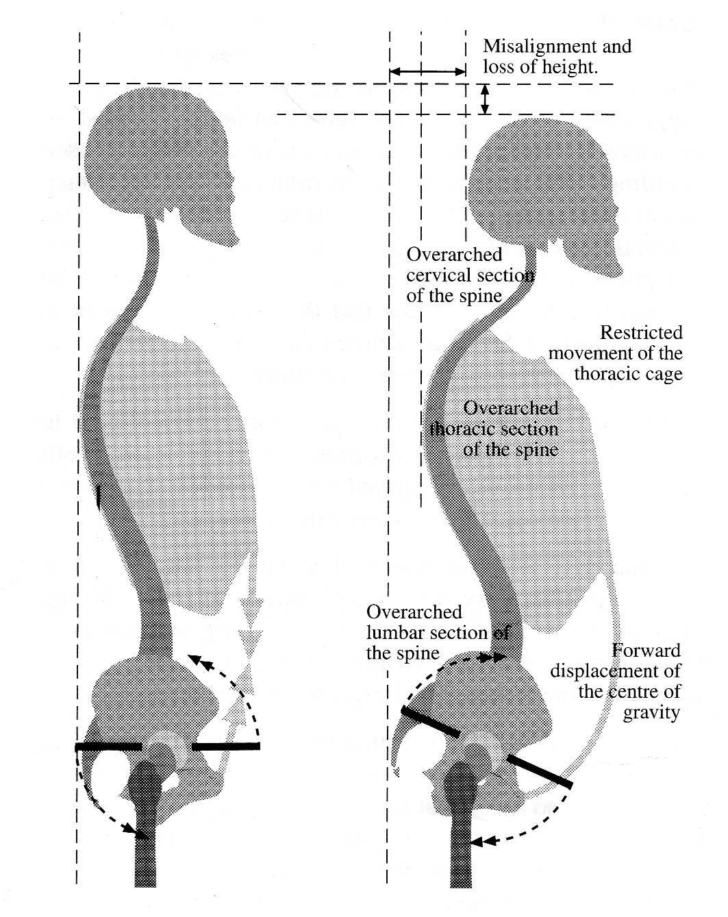

Slide 30
‘Alexander’ lying-down with paperback books or a yoga block (6-10 cm thick) supporting your head. Watch Pete’s video demonstration on Moodle.

Slide 31

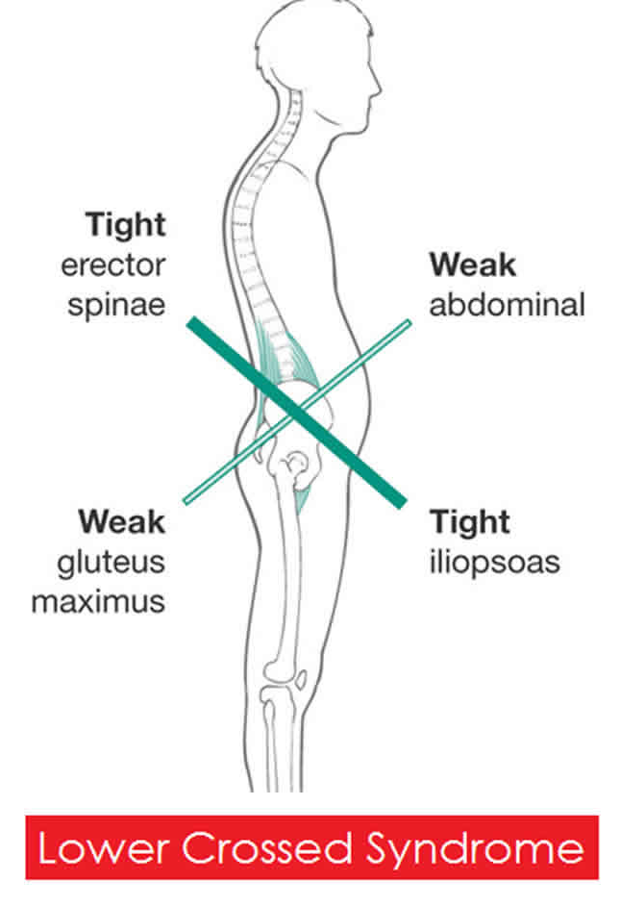

Slide 34
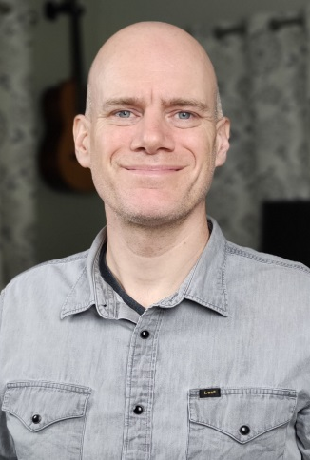
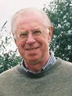

Alexander Technique Tutors
Su Harrison
Pete Robinson
Malcolm Williamson
AlexanderLessons@rncm.ac.uk
Jane Gray, Students Registry

