Slide 1
USING JSTOR
A guide to getting the best out of this full-text resource

Slide 2
Launched in 1995
Full-text access to journal articles / book chapters
Institutions can select subjects they subscribe to
UK mirror site at the University of Manchester

Slide 3
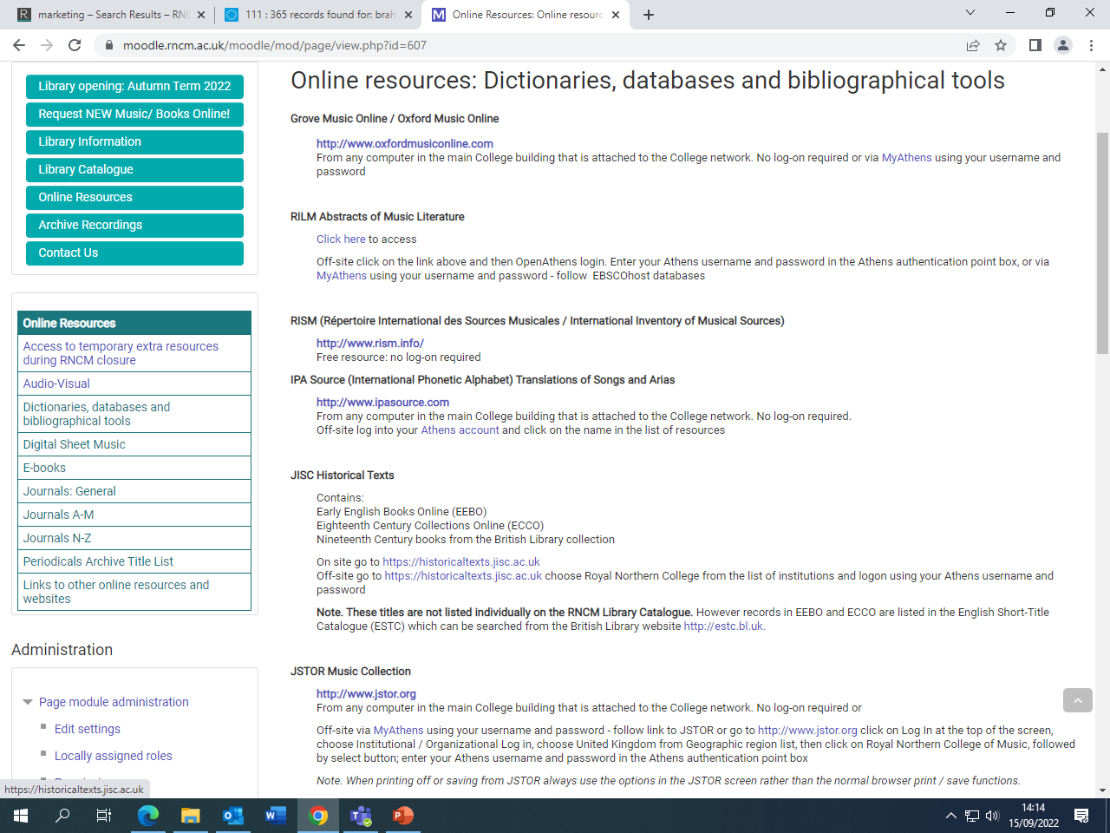

Slide 4
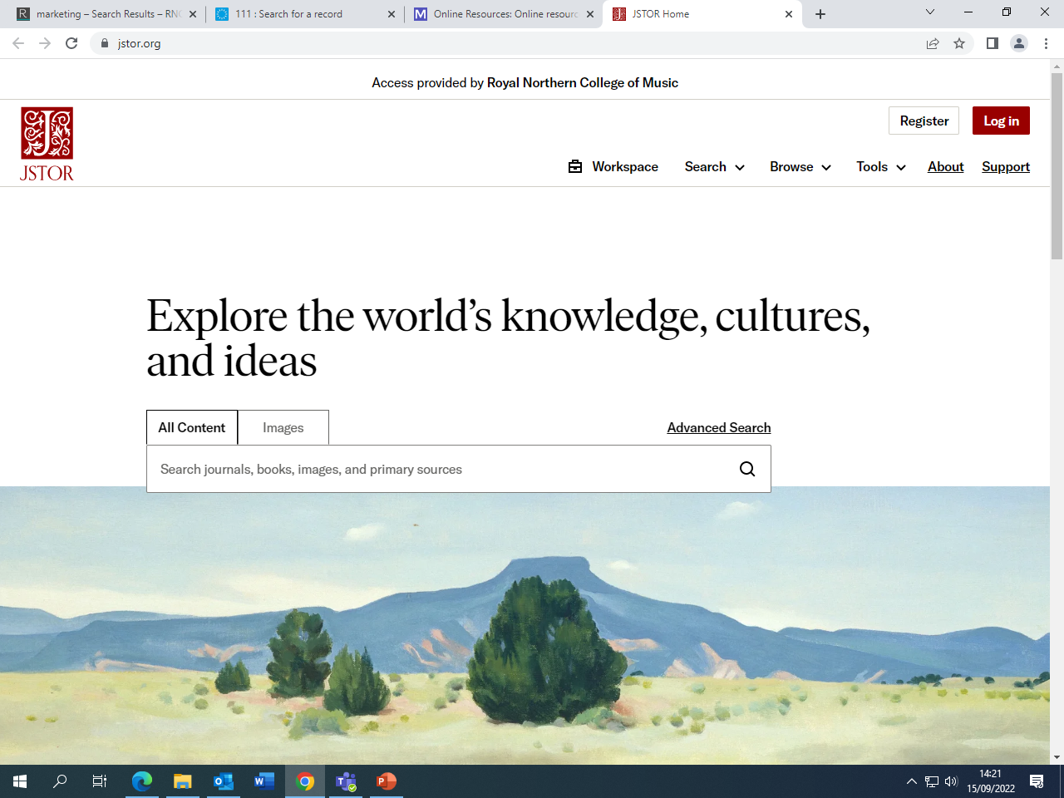

Slide 5
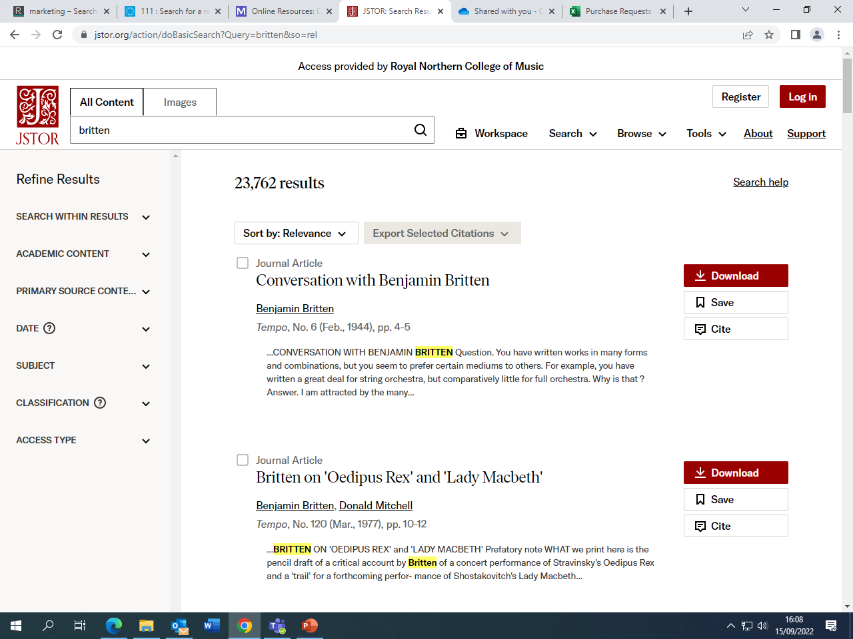

Slide 6
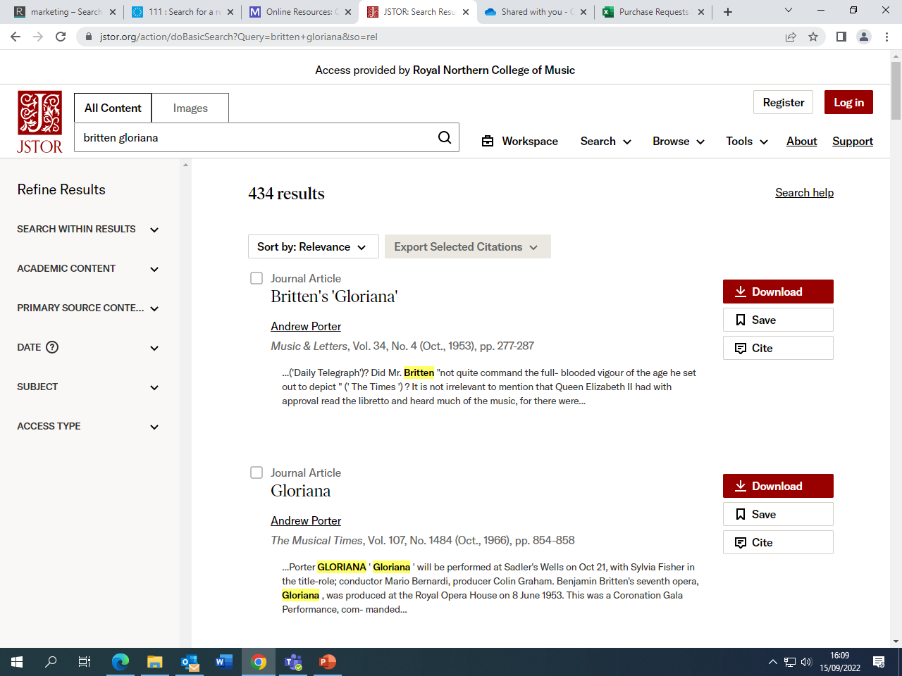

Slide 7
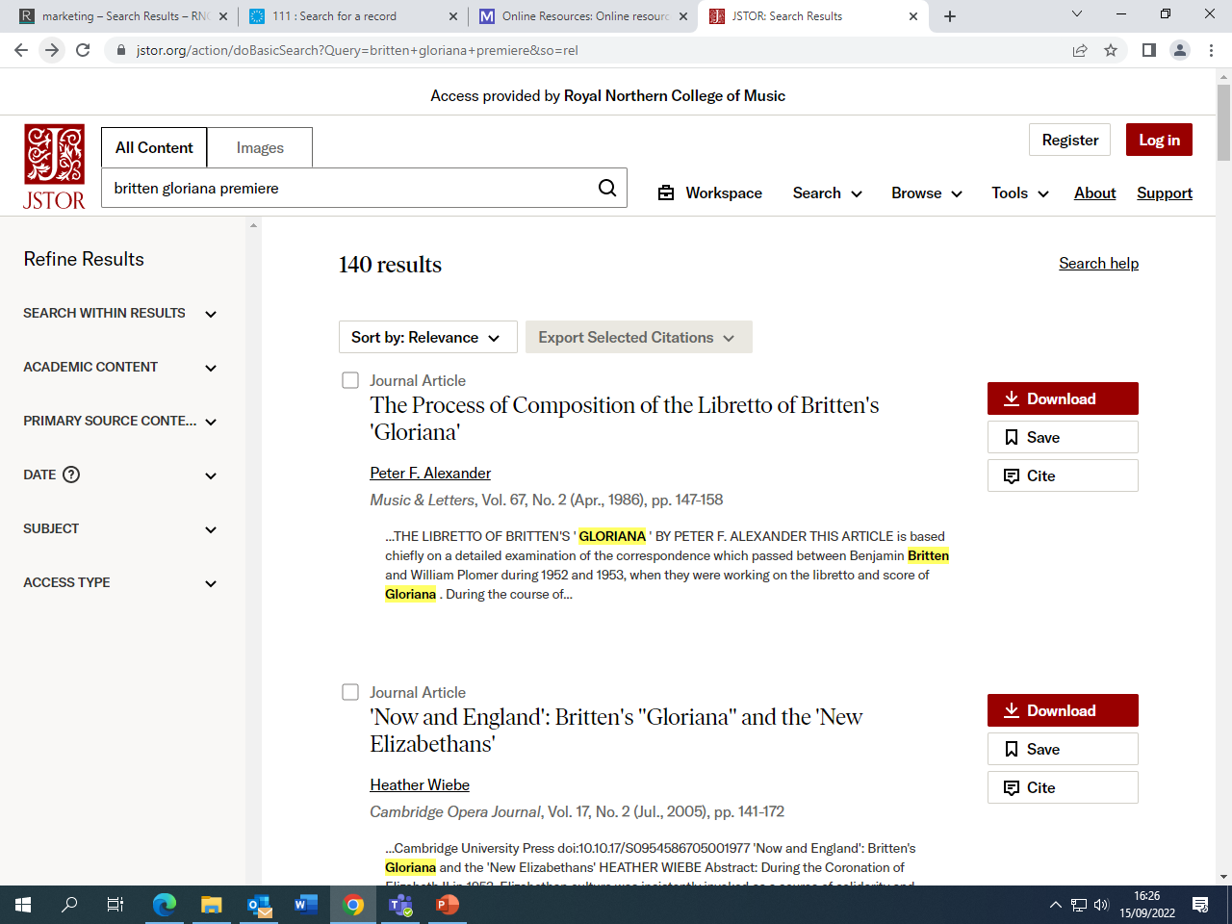

Slide 8
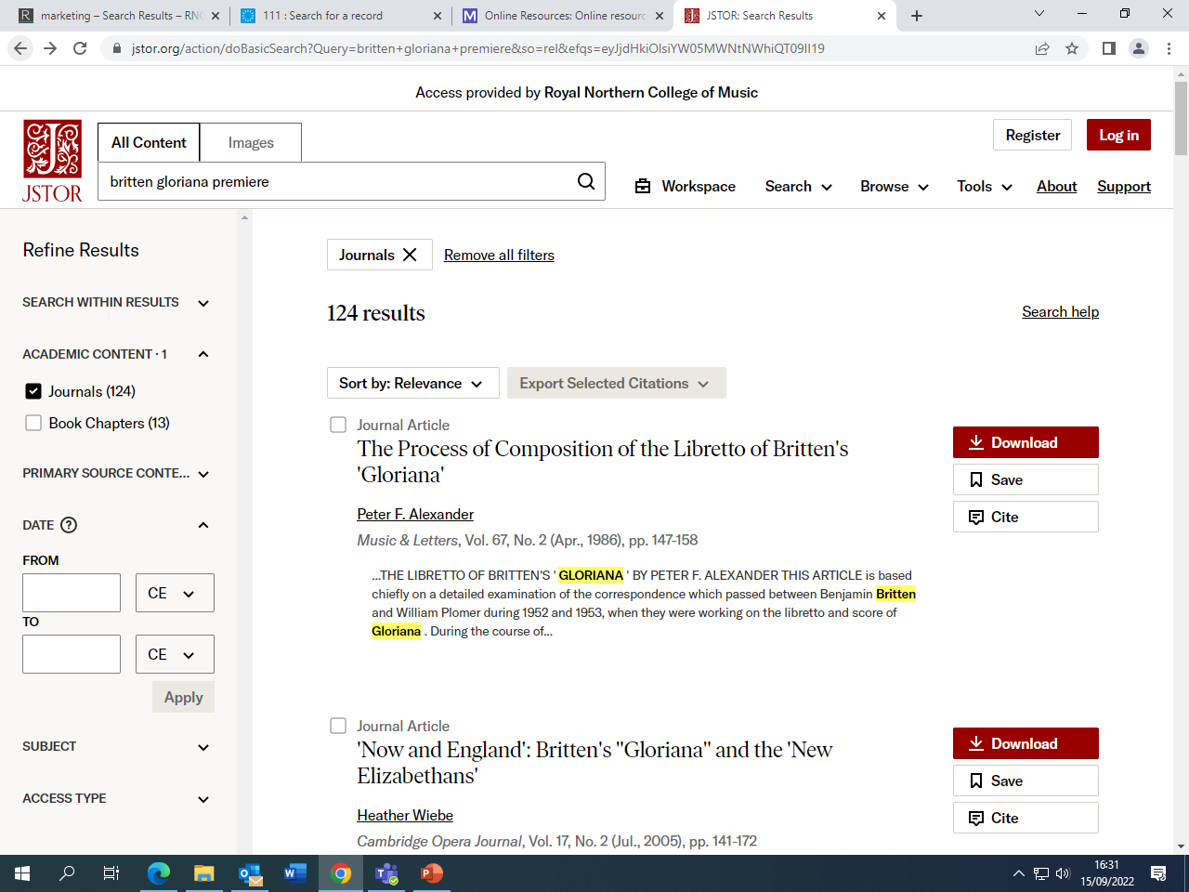

Slide 9
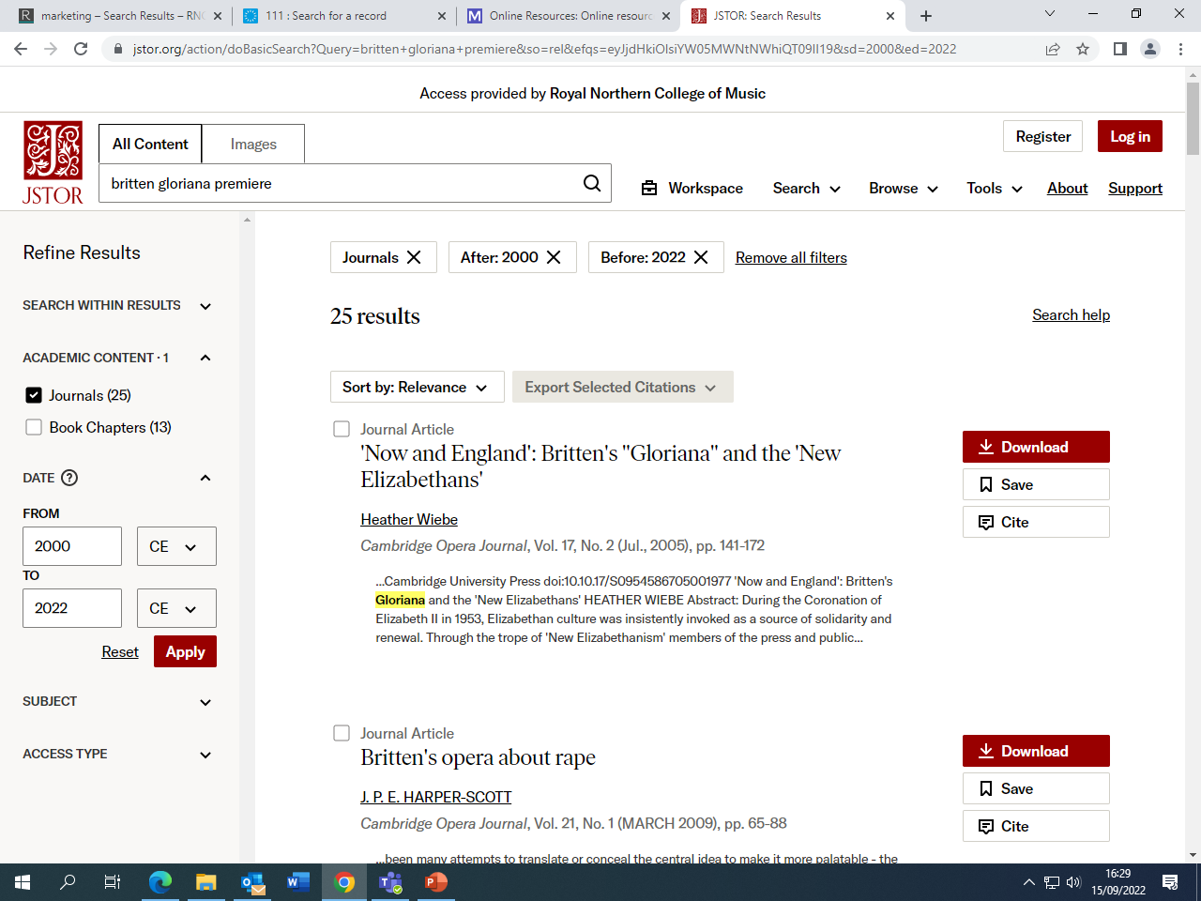

Slide 10
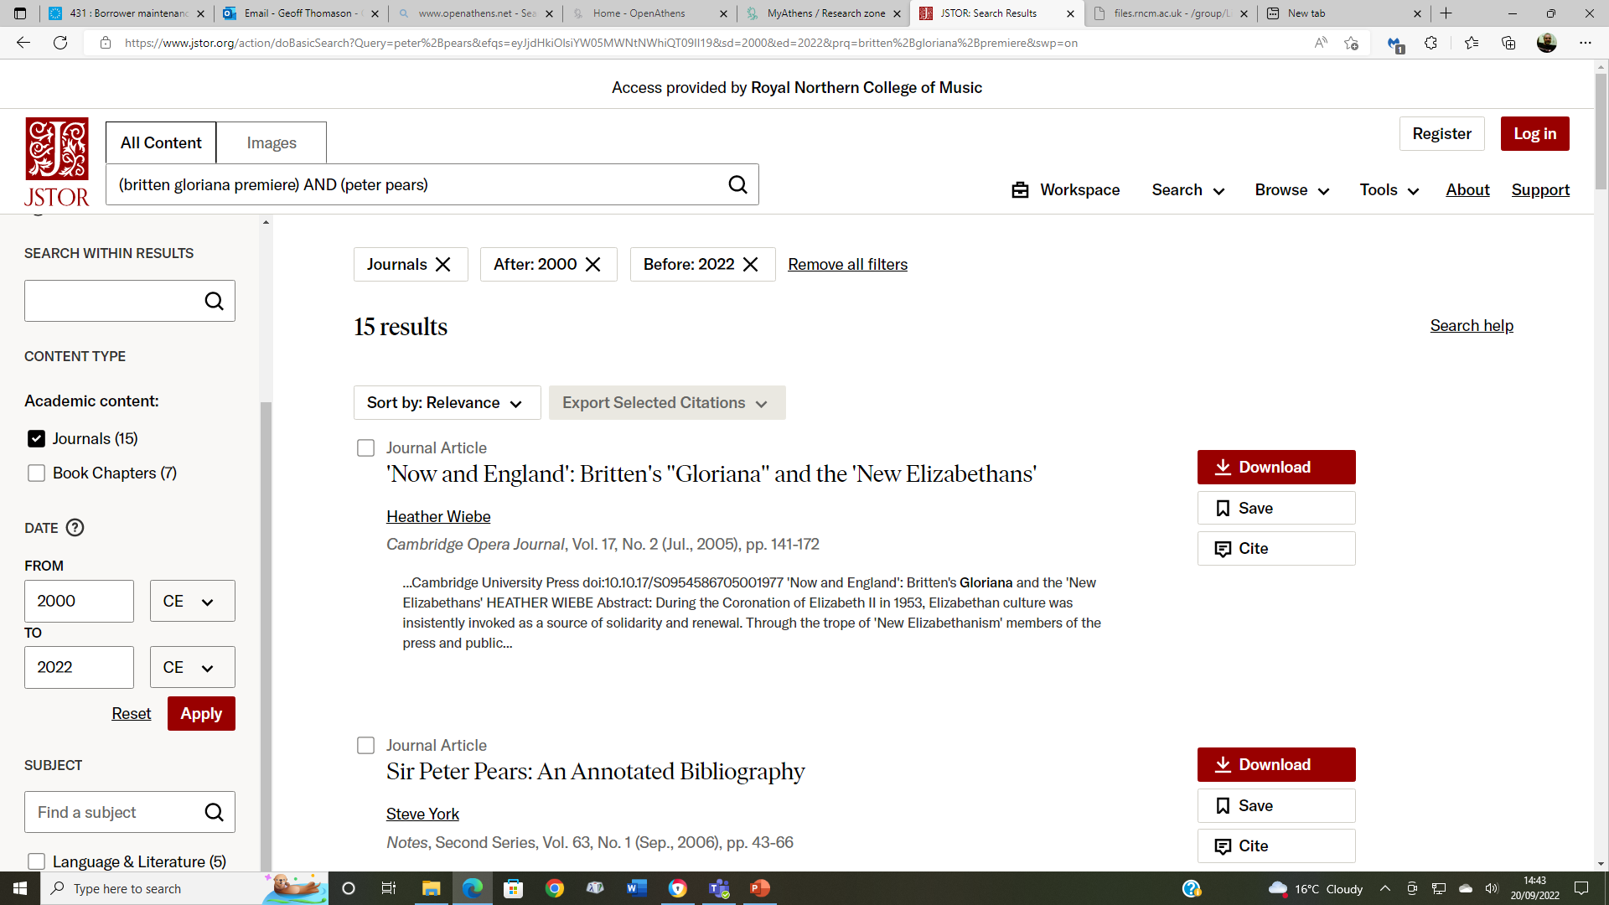

Slide 11
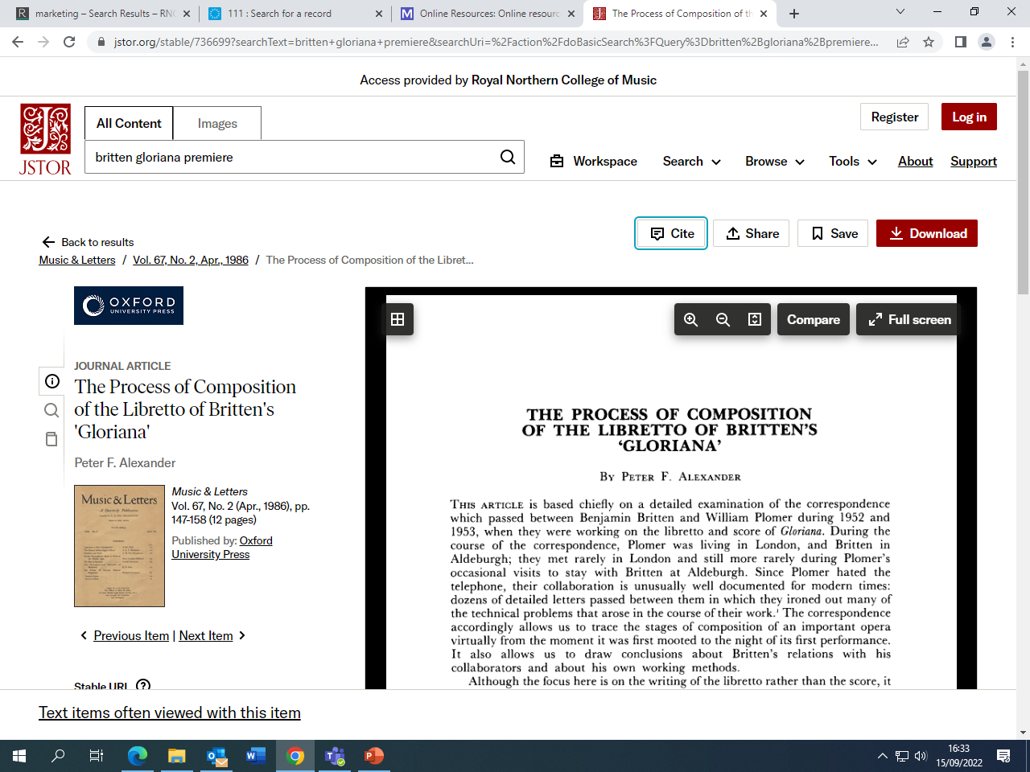

Slide 12
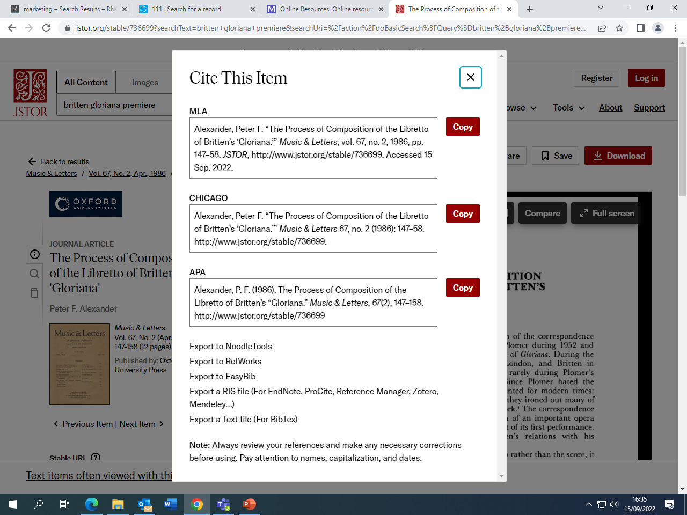

Slide 13
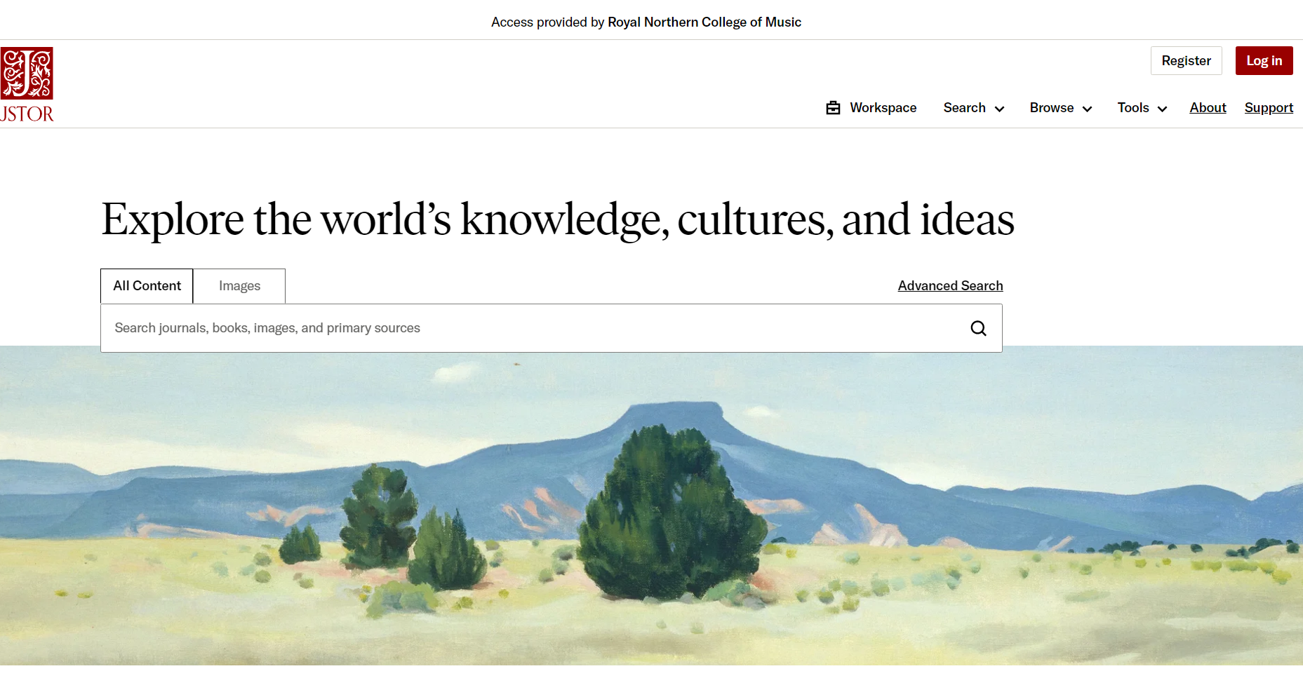

Slide 15
interlibraryloans@rncm.ac.uk
Libstaff@rncm.ac.uk

