Slide 1

RNCM Young Strings
Parents meeting Autumn Term 2024
Bluebirds Group

Slide 2
Musicianship
Kodály: develops musicianship through singing
Dalcroze Eurhythmics: develops musicianship through movement, singing and improvising

Slide 3
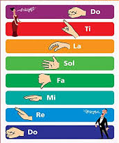
What is tonic solfa?
…a method for learning music
The system focuses the attention on pitch relationships and functions within a tonal system, so we can use it to train the musical ear for musical tasks like sight-singing and sight-reading, playing by ear and improvising.
‘Do’ is the key-note and it is moveable.
So far, Bluebirds musicians are very familiar with do, re, mi, so, la (pentatonic scale)

Slide 4
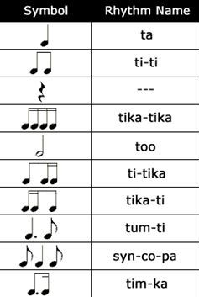
Rhythm development
Bluebirds musicians use the syllables opposite to help them learn rhythms; they also use movement words such as walk, jogging, skipty and stride.
At Young Strings, children learn about rhythm by experiencing it through song and movement first and then learning to recognise the notation for it, and to understand the theory behind it.

Slide 5
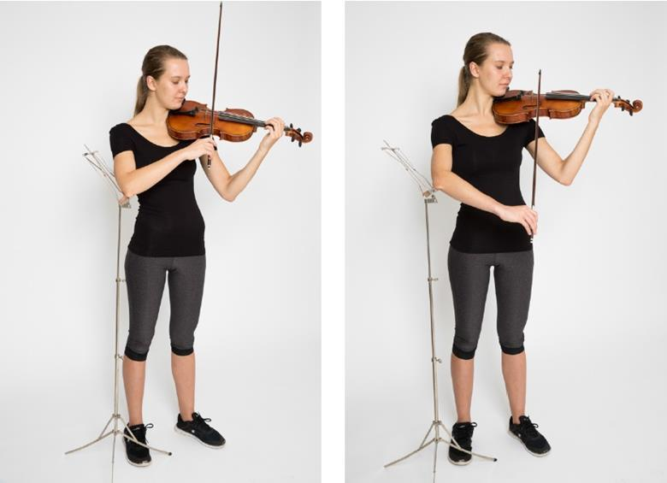
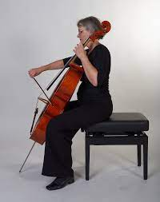
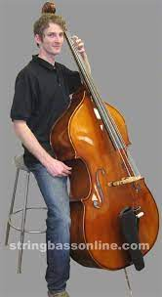
SITTING and STANDING TO PLAY

Slide 6
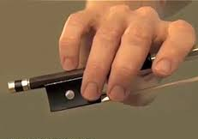
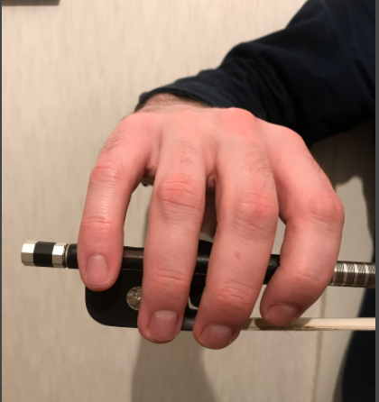
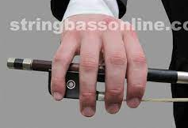
Bow hold
Violin and viola
Cello
Double Bass

Slide 7
Physical contact
Our teachers will generally not make physical contact with pupils during instrumental lessons; there are many other ways to help young learners develop healthy instrumental technique. However, there are certain circumstances in which your child’s teacher may find it helpful to use physical contact. This might include adjusting a bow hold or left-hand finger positioning.
In these cases, the teacher will always:
Tell the pupil exactly and specifically what they are going to do, and why
Ask the pupil if this is ok
Watch the pupil’s body language carefully, as well as listening to the response, to check that the pupil is comfortable with this
Make minimal and brief physical contact before stepping back out of the pupil’s personal space
If you or your child would like to speak to me about anything along these lines, please don’t hesitate to get in touch.

Slide 8
practice
How often and for how long?
Different for every child and family
Little and often can work very effectively at these early stages
A regular routine works for some children
Spontaneous practice sessions or performances can also be very effective
‘My child never wants to practise’!
Try to keep music-making at home as positive as possible and avoid a ‘battle ground’!
Create a quiet, calm space
Ask them if they would like you to stay with them, or whether they would like you to come back in 5 minutes to listen – you can help them decide what they are going to focus on
Practice games, informal performances, recording can all work well
Leave the instrument out somewhere accessible if it is safe to do so – effective practice can happen whilst waiting for a sibling to put a pair of shoes on!
Not all practice has to be done with an instrument in hand – also encourage listening to music, singing, rhythm work etc.

Slide 9
Performance, creativity, appraisal
In all classes at Young Strings, children are encouraged to perform in a safe and supportive environment. They are also encouraged to be a good audience for their peers!
Musical creativity is very important; children improvise movements in response to heard music, or to inspire musical composition. They also improvise vocally and instrumentally.
Self and peer appraisal is an important learning tool and children are encouraged to do this in all classes. Please ask your child lots of questions at home…what did you do well? Is there anything you would like to keep working on? Did you like the sound you made? Why did you choose to play it like that? It sounded a bit ’frightened’; can you now play it as though you feel really confident?

Slide 10
safeguarding
The RNCM is committed to ensuring the safety and welfare of children and adults at risk studying in the College by raising awareness of safeguarding and promoting a safe environment in which to learn and explore music.
RNCM safeguarding policies and procedures can be viewed and downloaded on the RNCM website.

